Slide 1
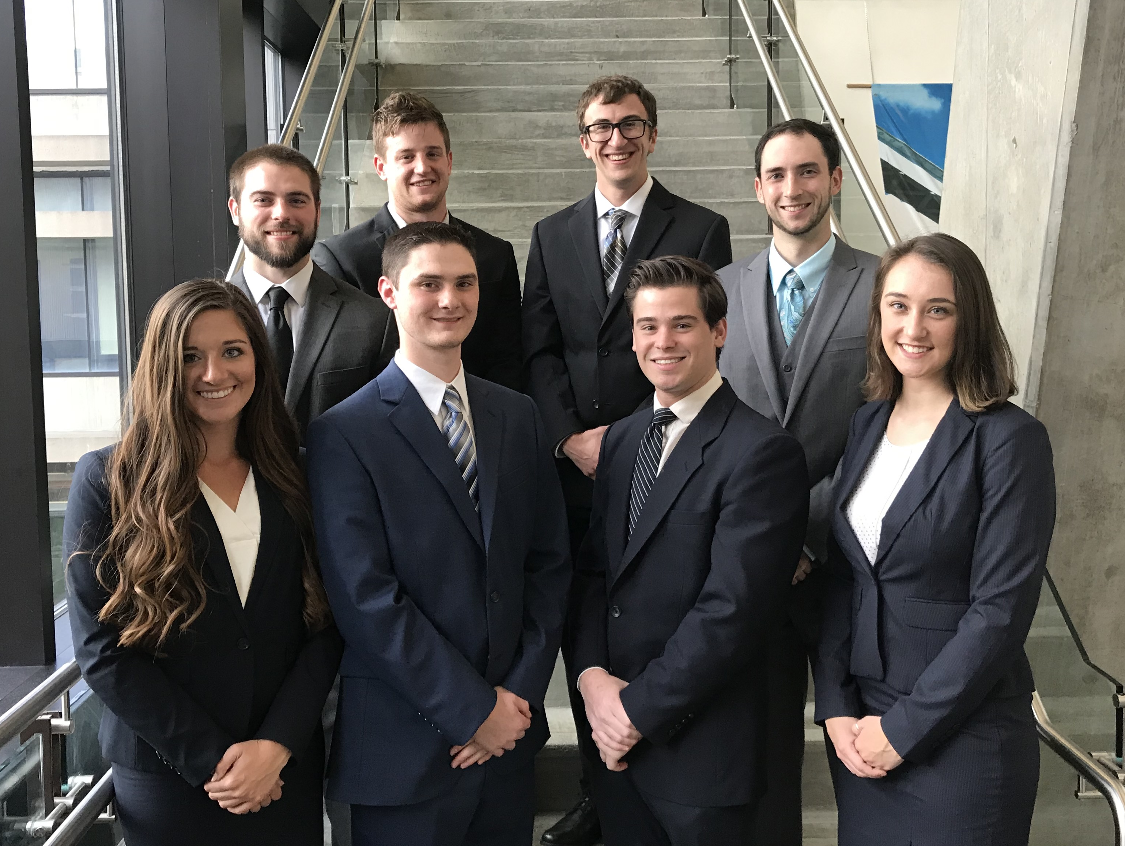
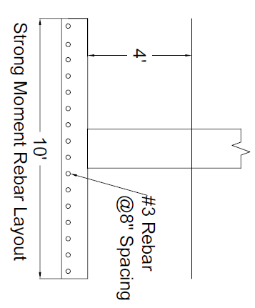
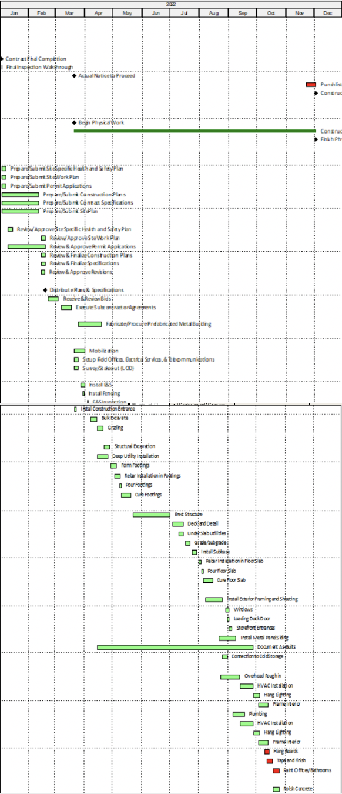
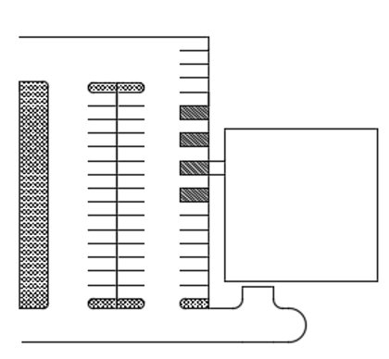
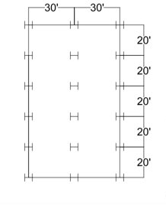
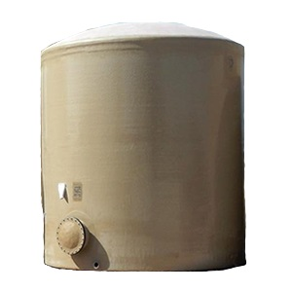
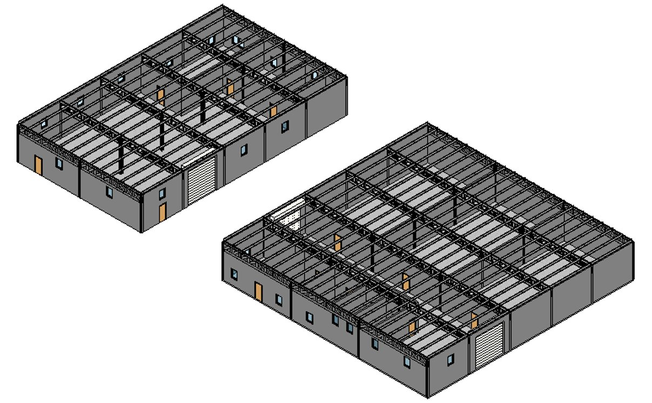
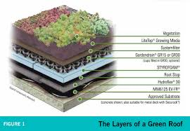
Millie’s Cold Storage and Manufacturing Facilities
Cream of the Crop Construction
Geotechnical
Construction Management
Footings
24 footings at Cold Storage facility
4 ft depth of embedment and 10 ft width
#3 bars at 8 in. spacing in strong moment direction and at 20 in. spacing in weak moment direction
18 footings at Manufacturing facility
4 ft depth of embedment and 10 ft width
#3 bars at 25 in. for both facilities
Parking Lot
(45) 9 ft x 18 ft parking spaces
3 handicap spaces to meet ADA requirements
1.5 in. surface layer and 4.5 in. base layer
Turnaround area for loading dock
Construction duration:
Cold Storage – 12 months
Manufacturing – 8 months
Total cost for project: $1,749,200
Phase 1: $1,172,200
Phase 2: $577,000
Risk contingency: $43,500
Health & Safety plan created with emergency responder details
Top: Mike Klena, Nathan Crikelair, Jordan Walk, Matthew Hanna
Bottom: Nicole Bell, Zach Michak, Andrew Ricci, Hannah Schell
ITEM | COST
PARKING LOT | $72,000
FOUNDATIONS & SLAB | $109,000
STRUCTURAL STEEL | $26,640
GREEN ROOF (w/ TANK) | $100,000
UTILITIES/TIE INS | $66,000
GENERAL CONDITIONS & OVERHEAD | $450,000
RISK CONTINGENCY | $43,500
ITEM | COST
FOUNDATIONS & SLAB | $59,000
STRUCTURAL STEEL | $12,700
FINISHES | $95,000
UTILITIES/TIE INS | $45,000
GREEN ROOF | $55,000
OVERHEAD & GENERAL CONDITIONS | $339,000
RISK CONTINGENCY | $24,000
Summary
Millie’s Homemade Ice Cream is rapidly expanding and needs a larger storage capacity. In order to fulfill their needs, we proposed a design for a Cold Storage facility that can hold 100,000 pints, 5,000 1-gal containers, and 3,000 3-gal containers per the owner’s request. The facility is 10,000 ft² and has 3 identical 60 ft x 33 ft freezers.
The site location was selected to be in the Waterfront where there is potential to expand the production by adding a Manufacturing facility. This site was selected to be the best in terms of risk, accessibility, expansiveness, cost, and site parameters.
The Manufacturing facility is an expansion of the Cold Storage facility and will be 6,000 ft². This building will have 30 employees with multiple offices for logistics personnel. The manufacturing floor was left open for flexible equipment needs.
Structural
Environmental
Columns
24 total columns for the Cold Storage facility
Selected W14 x 74 sections for exterior columns
Selected W10 x 33 sections for interior columns
18 total columns for the Manufacturing facility
Selected W14 x 53 section for exterior columns
Selected W10 x 33 sections for interior columns
Truss
Flat Warren truss selected for both facilities
(2) back to back channels selected for top and bottom truss members
W sections selected for diagonal truss members
Channels transfer roof load and placed above truss joints
Water Tank
Sizing based off monthly demand of 7,750 gal
10,000 gal tank was chosen
Fiberglass tank
Supplies storage facility with sanitary water
Total cost of $9,900
Intensive Green Roof
16,000 ft² total
Filters storm water for reuse
Reduces HVAC costs for storage
Natural filtration for reuse of runoff
Accomplishes Millie’s goal for sustainability
Total cost of $90,000

