Slide 1
Silicon carbide MOSFET traction inverter operated in the Stockholm metro system - demonstrating customer values
Presented by Henry Wesling
Written by Magnus Forsén
2018-10-15

Slide 2
Abstract: In the mid-nineties, Bombardier Transportation took a technology step forward, moving from Gate Turn Off Thyristor (GTO) based Traction Converters to Si IGBT based Traction Converters on the C20 project for Stockholm Metro. Since then, this technology has taken several steps with regards to nominal current, losses, and operating conditions. Many advancements have been made in Si IGBT power electronics for transportation applications in both the rail and automotive sectors.
However, the Railway industry stands in front of the next technology step when it comes to semiconductors, which is introducing high power density SiC (Silicon Carbide) MOSFET´s into the traction chain. There is hardly any other application that puts such high demands on components such as traction. High quality, reliability and lifetime are the most important product features in this market. There will still be some years before SiC is seen in commercial operation; but this presentation will tell something about the potential of the new technology, and what the future holds.
The results from a full-scale field test on the Stockholm Metro, where the state of the art IGBT converters from the mid-nineties were replaced with a SiC prototype, will be presented.

Slide 3
Silicon Carbide MOSFETs Challenge IGBTs
SiC technology has undergone significant improvements that now allow fabrication of MOSFETs capable of outperforming their Si IGBT cousins, particularly at high power and high temperatures.
SiC is a better power semiconductor than Si, because of a 10-times higher electric-field breakdown capability, higher thermal conductivity and higher temperature operation.
The switching losses of a SiC MOSFET are less than half those of a Si IGBT. Combining this switching-loss reduction with its lower overall conduction losses, and its higher operating temperature, it is clear that the SiC switch is a much more efficient device for high-power-conversion systems.

Slide 4
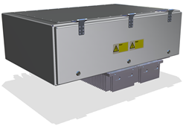
Agenda
1
Bombardier Transportation Energy & Motion
2
Project introduction
3
Laboratory test
4
Field test
5
Summary

Slide 5
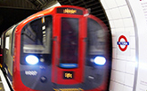
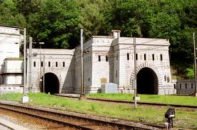
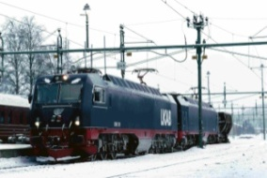
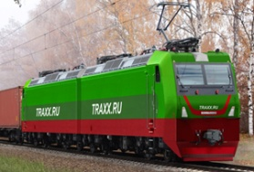
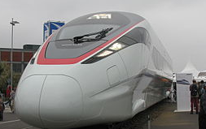
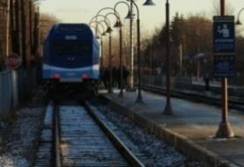
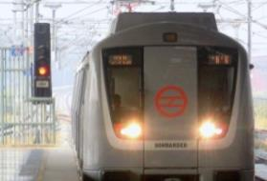
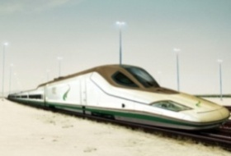

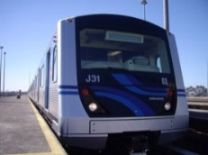
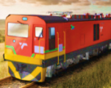
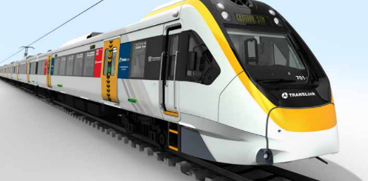
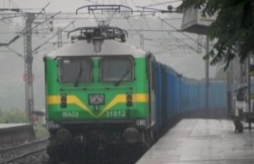
Our Products Must Provide Reliable Operation in all Environments
Temperatures, Air Pollution, Sand, Dust, Rain, Snow, Flood, Track Quality
Switzerland, Eurotunnel: Rapid temperature
changes with high humidity (Simplon effect)
Russia, Scandinavian countries:
Cold climate: Starting at -50°C, nordic snow and ice
London Underground
Track quality (vibrations)
China: Wide climate
range, air quality
N. America: Cold climate,
snow, track quality
Israel, Saudi Arabia: Hot
desert climate, sand
Brazil: Tropic environment and
high temperatures in tunnels
South Africa: Air temperature
exceeds 100°C in tunnels
Australia: Maritime
climate
India: Hot & tropic
weather, air quality, flooding

Slide 6
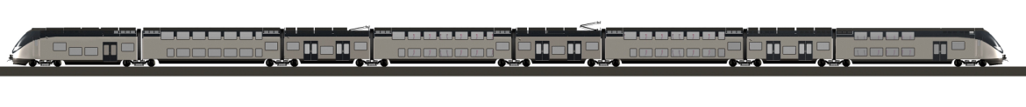
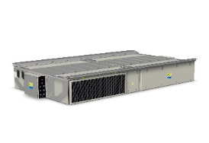
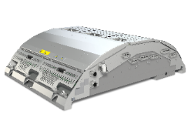
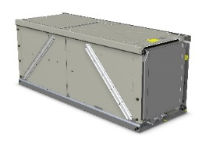
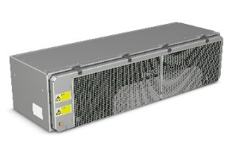
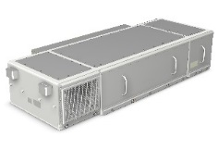
Our Traction Converters
Different Mounting Options
MITRAC
TC 1500
MITRAC
TC 1100
MITRAC
TC 1200
MITRAC
TC 1300
MITRAC
TC 1400
Under frame mounted
Roof mounted
Machine Room mounted
Stand Alone solution
Flexible mounting
Suitable for high floor vehicles from metros up to very high speed applications Compact underframe mounted system for small space requirements and reduced number of propulsion products | Roof mounted, where low floor entry is needed Primarily for commuter- and regional trains. | Machine-room mounted solutions, allowing converters to be incorporated in the car body in double deck trains and high speed powerheads. | Standalone solutions (products) Primarily for high floor metros and electrical multiple units | Standardized product, different mounting- and cooling options Enabled for silicon-carbide for metros up to very high speed applications

Slide 7
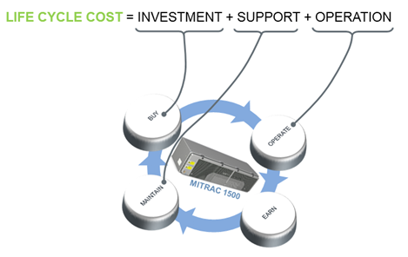
Agenda
1
Bombardier Transportation Energy & Motion
2
Project introduction
3
Laboratory test
4
Field test
5
Summary

Slide 8
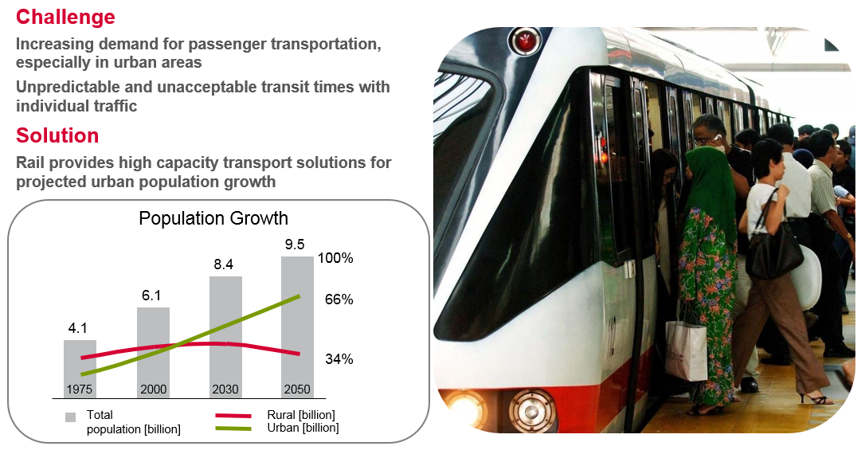
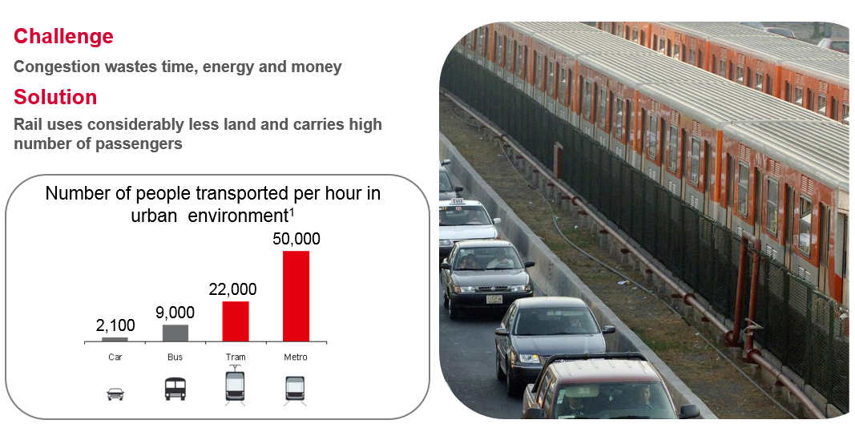
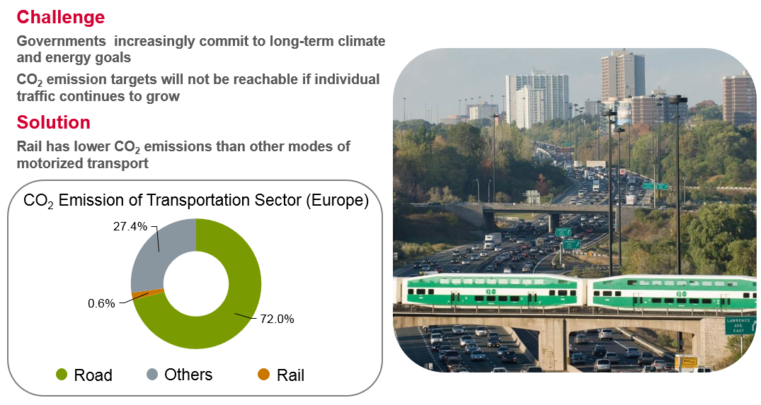

Megatrends Drive Need For New Developments
Urbanization
Congestion
Environmental awarness
Life Cycle Cost

Slide 9
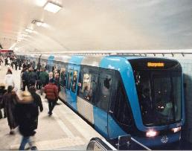


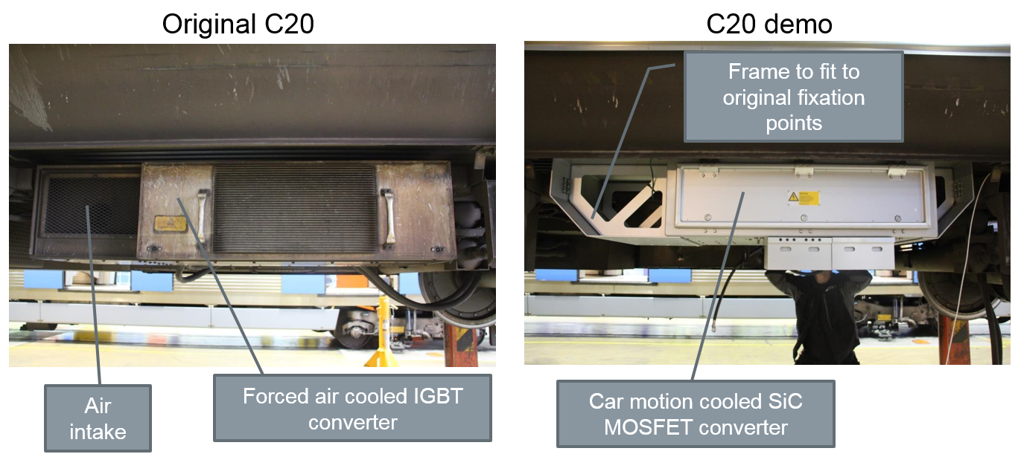

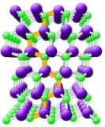
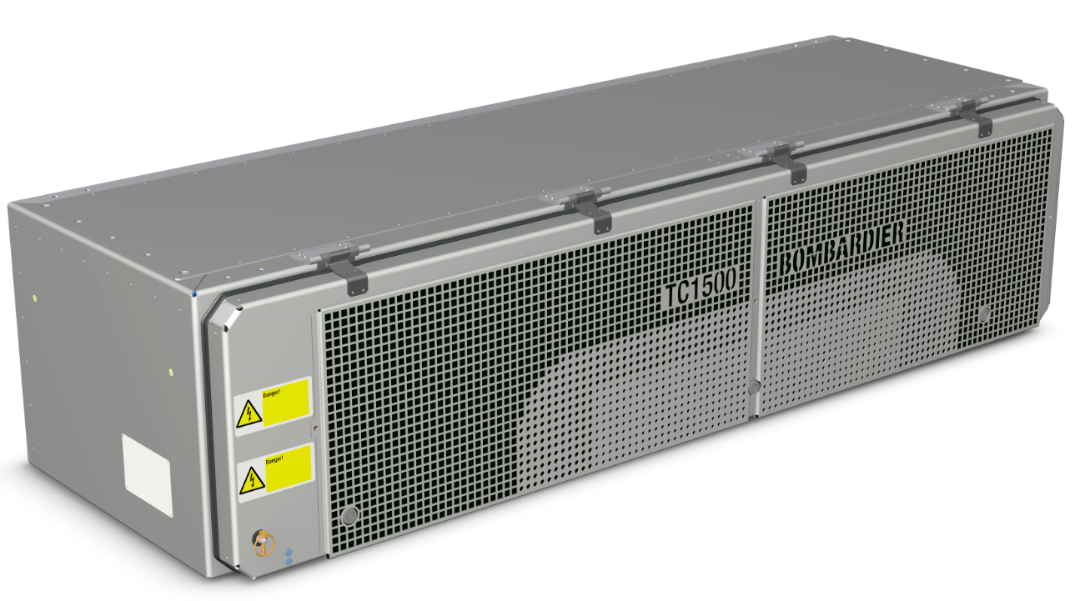
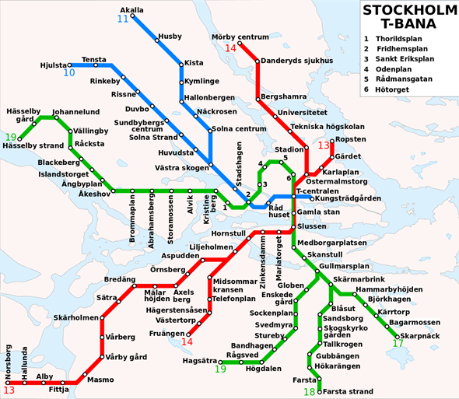
Stockholm Metro SiC demonstrator project
GreenSiCtrac Demo - Overview
PARTNERS
Swedish Energy Agency – Financial sponsor
Storstockholms Lokaltrafik, SL – Fleet owner
MTR Tech – Operator & Maintainer
KTH – Kungliga Tekniska Högskolan - Academic Partner
RISE/Acreo – Research institute
PURPOSE
Losses
Size
Weight
Noise
SiC
Performance density
PROGRAM
C20 MOVIA Train Application Stockholm Metro Green Line
Pre-study Q3 2016- Q1 2017
Design and Test Q2-Q4 2017
Installation and Passenger service Dec 2017 – Mar 2018
MITRAC is a trademark of Bombardier Inc. or its subsidiaries. SiC: Silicon Carbide MOSFET
Notes:
Och det är här vår C20 Green SiCtracdemo kommer in i bilden. Tillsammans med våra partners har vi demonstrerat vad vi kan åstadkomma med den senaste tillgängliga tekniken baserat på SiC. Vi har konstruerat en maskinströmriktare med avsevärt högre effektdensitet och med det också möjligheten att inteckna andra fördelar i form av lägre volym, vikt, förluster och oljud.
Arbetet påbörjades med en förstudie 2016 och avslutades i helgen som gick då vi monterade ned strömriktaren framför oss från Karin (litt 2028) där den suttit i reguljär trafik sedana 1:a advent 2017 då vi tog den idrift i Högdalsdepån. Som av en händelse alltså har vårt Gröna Drivsystem körts på den Gröna Linjen ;-)

Slide 10
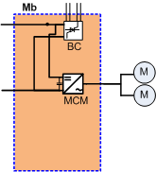
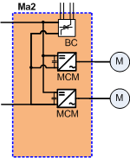
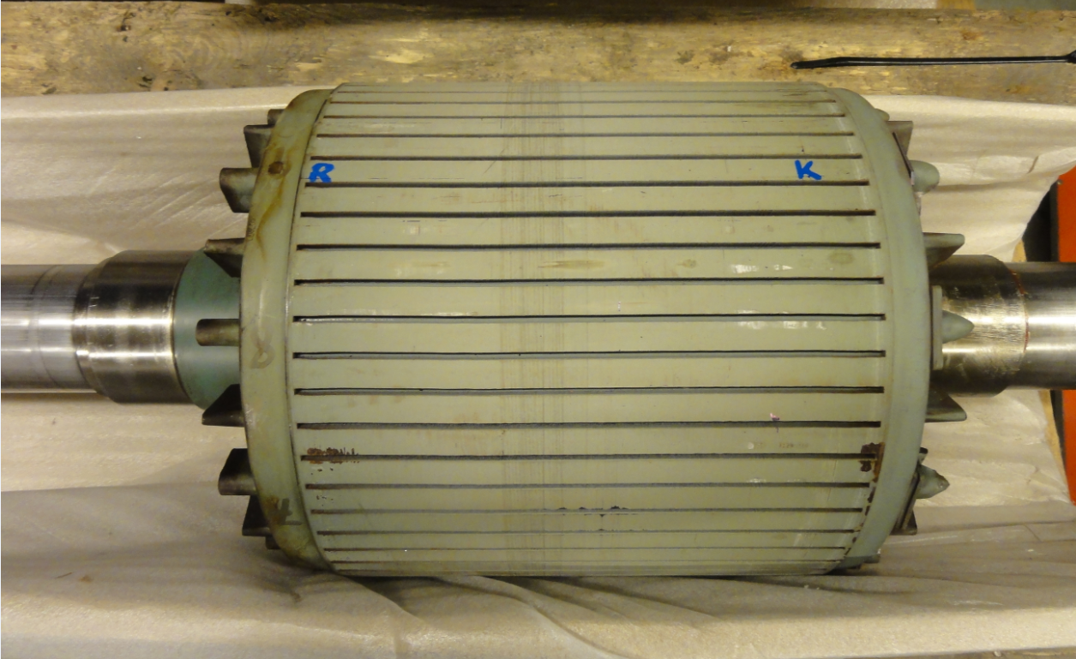
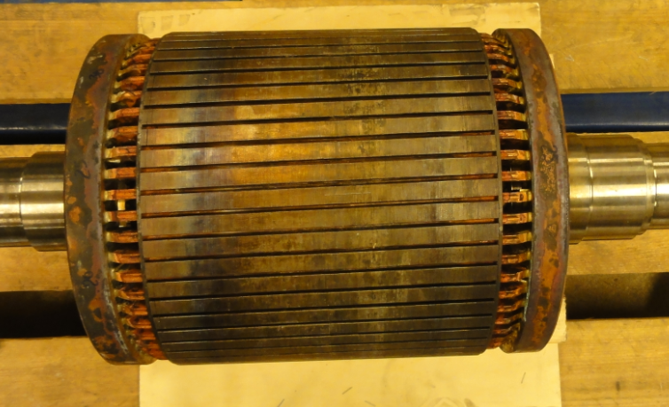
Stockholm Metro demonstration – New technology
Replace existing 1st generation IGBT converter (forced air cooled) with new TC1500 SiC converter (car motion cooled)
Increased switching frequency with SiC
Change drive topology from bogie drive (2//motors) → Single axle drive
Replace rotor in existing traction motors with new low loss design (optimized Cu rotor design)
Aluminium rotor
Copper rotor (low resistance)

Slide 11
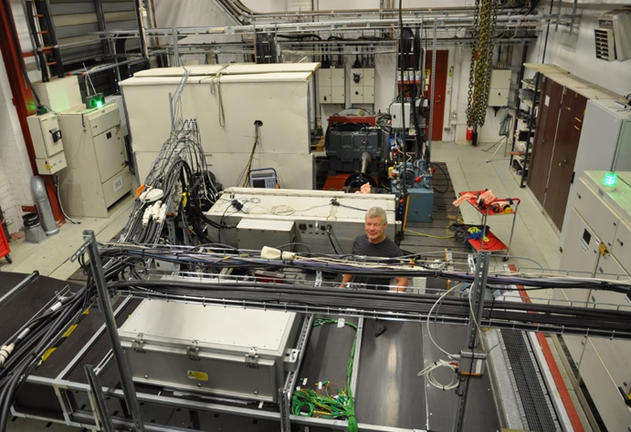
Agenda
1
Bombardier Transportation Energy & Motion
2
Project introduction
3
Laboratory test
4
Field test
5
Summary

Slide 12
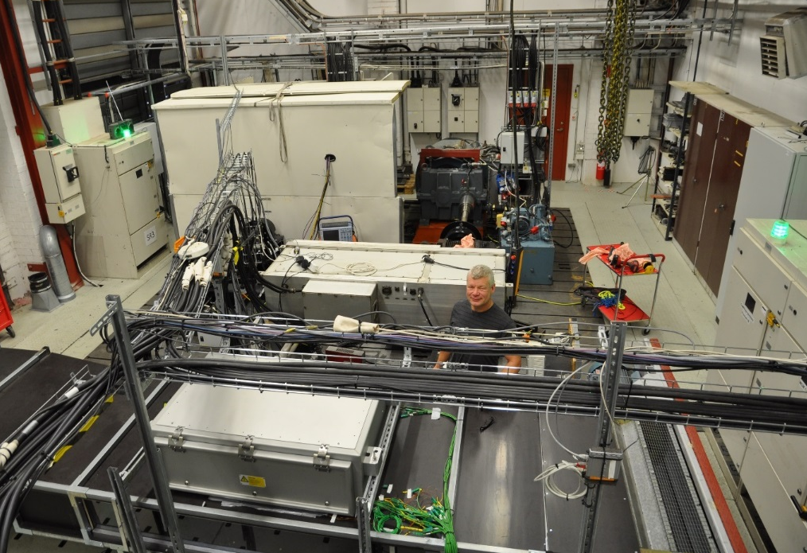
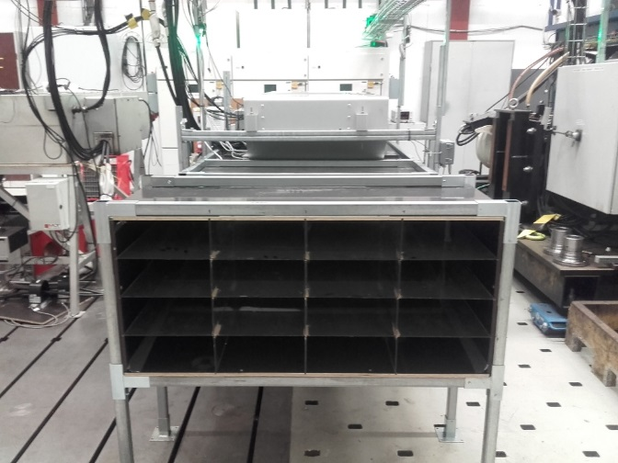
Test setup in Power Lab (Bombardier Västerås)
C20s existing 1st gen
forced air cooled
IGBT converter
(mid 90`s)
Car motion cooling
Reduced maintenance –
no moving parts,
no air filter cleaning
Noise from blower
eliminated
No aux power
consumption for blower
New car motion
cooled (passive)
SiC converter
Air tunnel to simulate air flow
from moving train

Slide 13
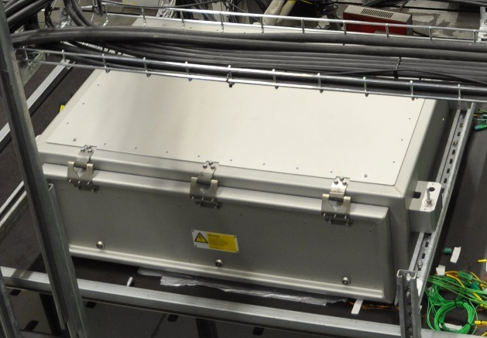
Laboratory test conditions
Fix point test conditions:
Carrier based pulse width modulation (PWM)
Train speed 45 km/h
DC-link voltage 640 V
Phase current 210 Arms
Varying switching frequency in steps of 1000 Hz
Ambient temperature 20-25 °C

Slide 14
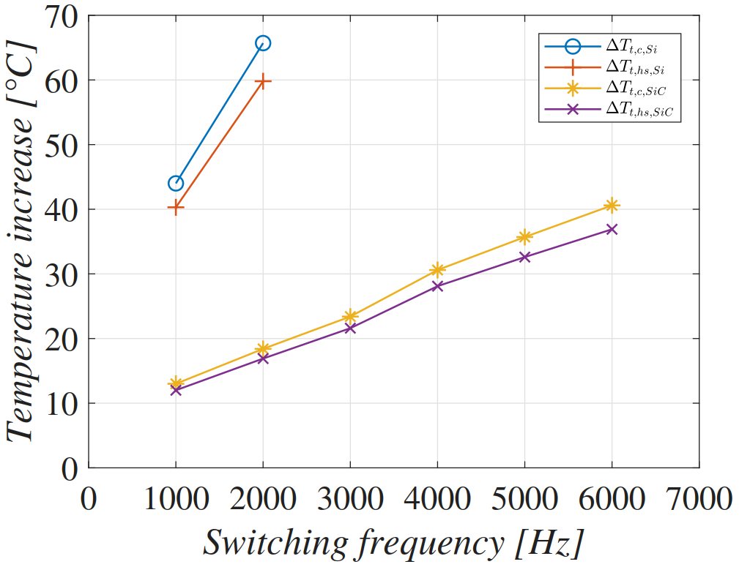
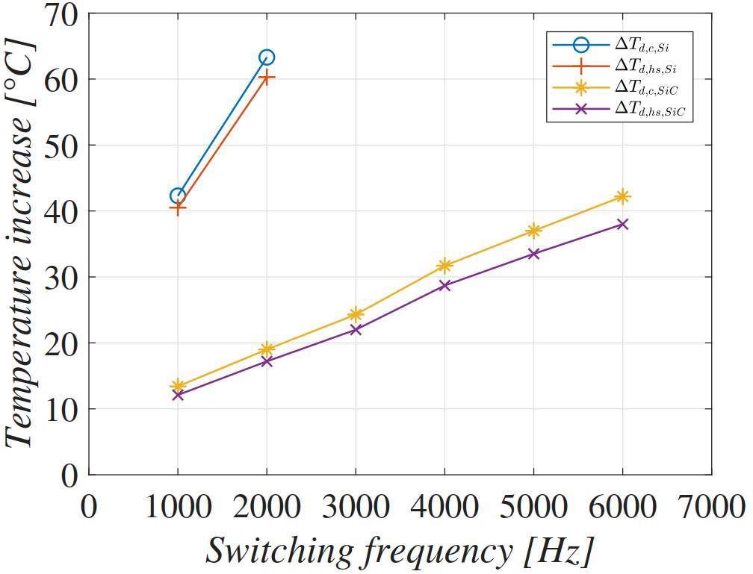
Laboratory test results
Steady state: Measurements taken when thermal equilibrium had been reached
Temperature increase over ambient is reported
63 % reduction of transistor case temperature when going from Si to SiC for 2000 Hz case
Transistor
Diode

Slide 15
Comparison switching losses SiC vs Si IGBT
Si 1000A/1.7kV
SiC 900A/1.7kV

Slide 16
Heat sink temperature – Si vs SiC
°C
- 60%

Slide 17
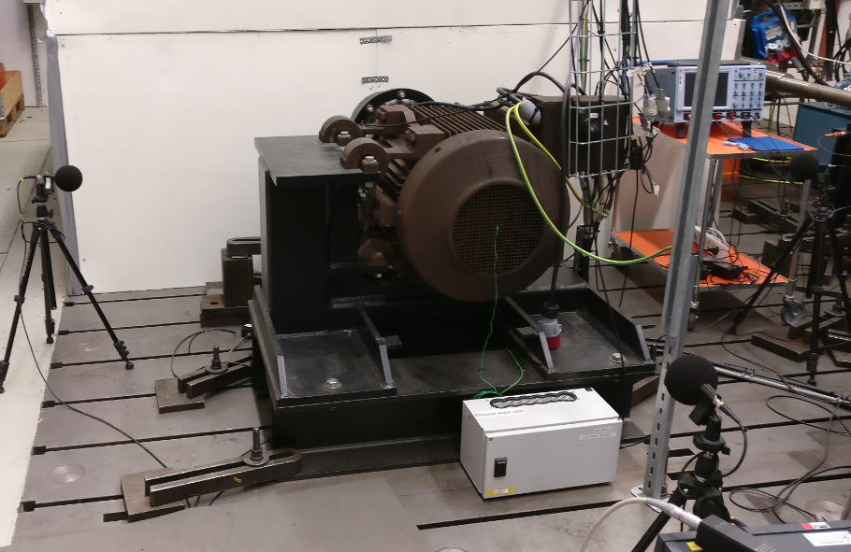
SiC technology enabling system advantages
Reduced motor noise by approx. 20 dB(A)
Acoustic measurement on a motor at no-load and maximum flux with sweep of the switching frequency (motor speed corresponding to 10 km/h)
Impact of noise induced
by switching
20 dB(A)
Notes:
In presentation mode: Click on the loud speaker sign to get the line move and the audio on. Not on the play button
OPTION: Show the film made including the switching noise

Slide 18
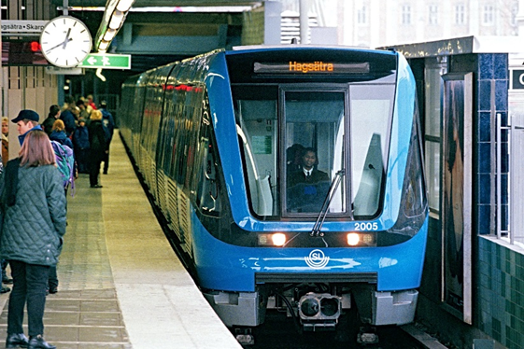
Agenda
1
Bombardier Transportation Energy & Motion
2
Project introduction
3
Laboratory test
4
Field test
5
Summary

Slide 19
Field test
Field test performed from December 4, 2017 until March 9, 2018
Duration of test decided beforehand
Original Si IGBT inverter replaced with SiC MOSFET inverter
Normal passenger service
Green Line in Stockholm Metro
Switching frequency 1000 Hz for the carrier based PWM during service
      Noise passing tests done at a higher Switching frequency

Slide 20
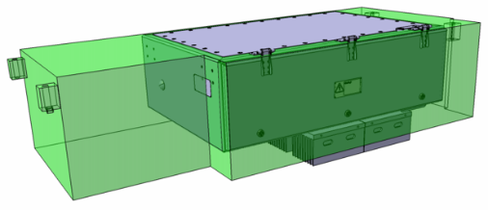
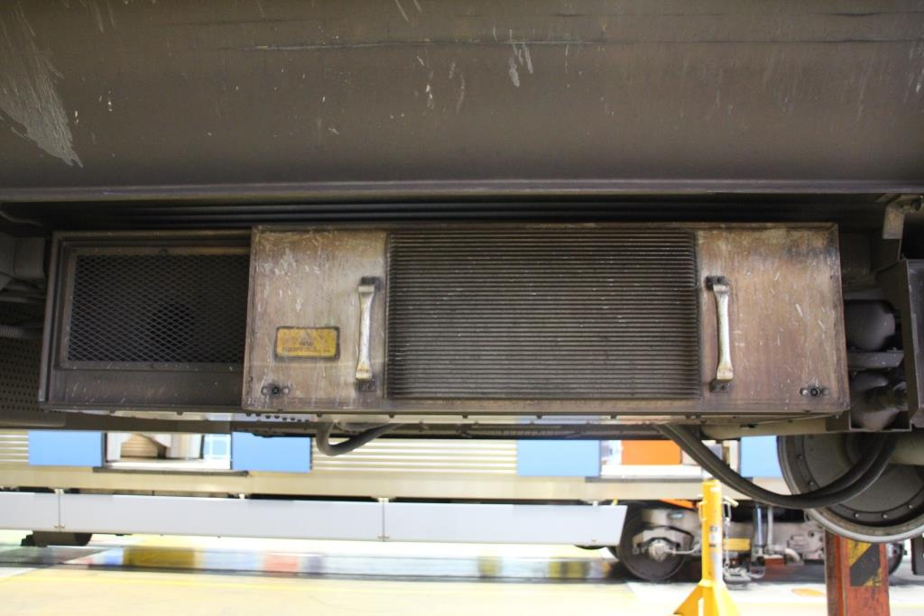
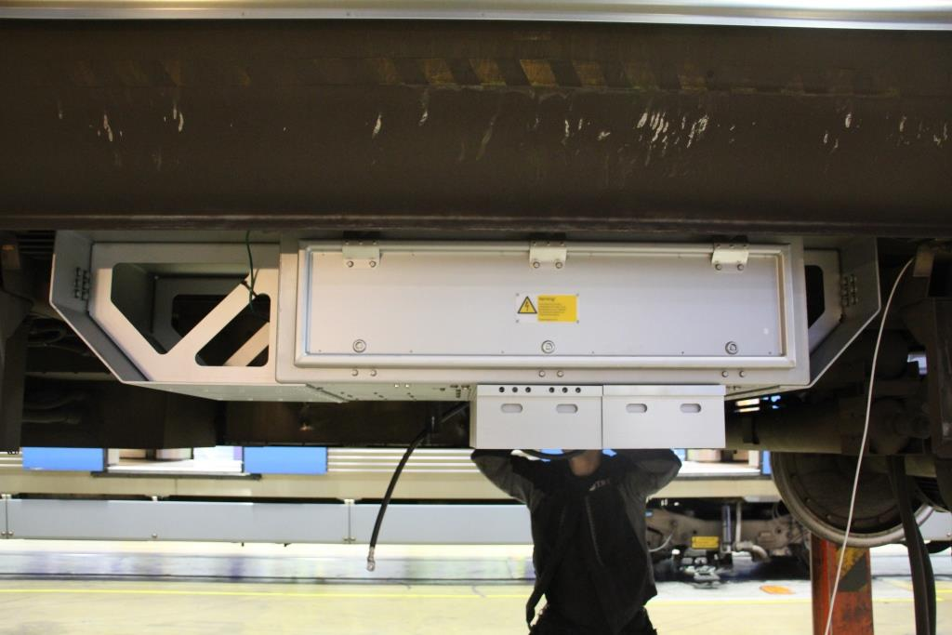
Converters mounted on train no 2028 ”Karin”
Original C20
C20 demo
Frame to fit to original fixation points
Air intake
Forced air cooled IGBT converter
Car motion cooled SiC MOSFET converter

Slide 21
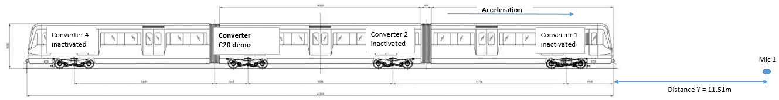
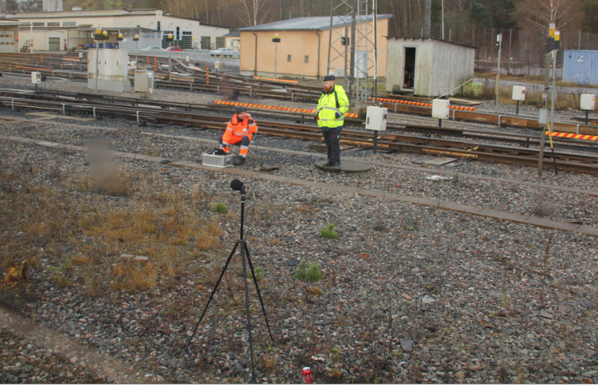

Noise mesurement near the track of passing train
10 dB
5 dB
Train passing by with only
SiC converter activated
1000 Hz
3500 Hz
6000 Hz

Slide 22
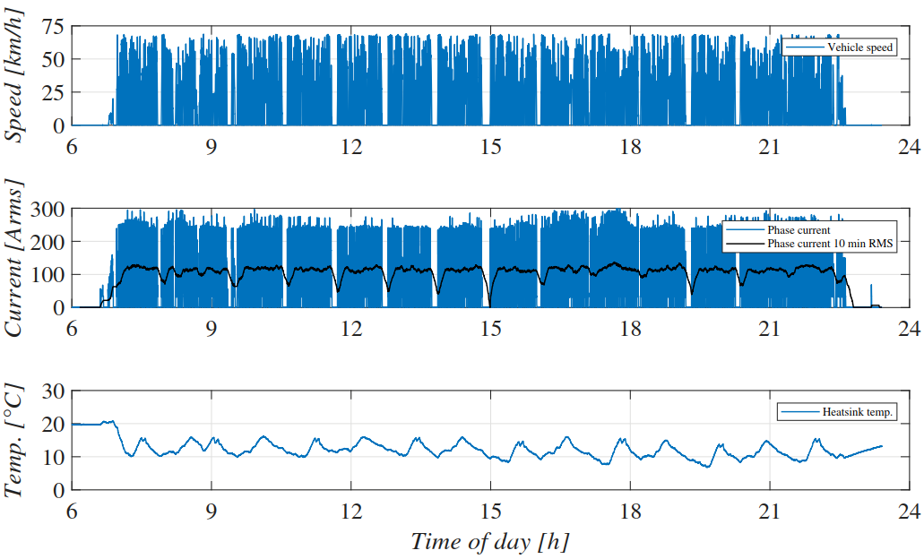
Field test results
Example day:
March 7, 2018
Outdoor temperature
-1 °C
Flawless operation
with SiC
throughout test

Slide 23
Agenda
1
Bombardier Transportation Energy & Motion
2
Project introduction
3
Laboratory test
4
Field test
5
Summary

Slide 24

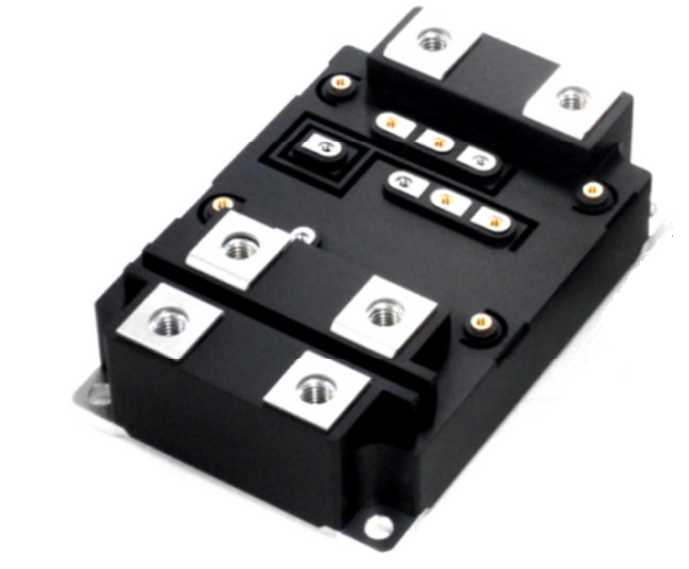
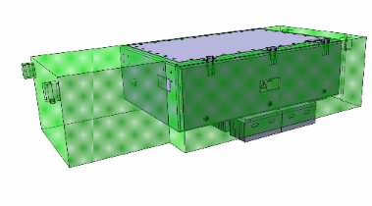
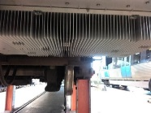
Stockholm Metro demonstration
Summary of changes and results
CHANGES
RESULTS
51% size
SiC in next generation semiconductor package for traction
22% weight
Low loss rotor design
34% loss
Higher switching frequency
19 dBA motor noise reduction (switching induced)
Car Motion Cooling
(passive – no moving parts)
0 x fan maintenance
Single axle control
No restriction on wheel diameter difference -
less turning of wheels – less maintenance costs

Slide 25
Life Cycle Cost Impact
RESULTS
IMPACT
51 % size reduction
22 % weight reduction
~ 3 seats / train
more passengers – more revenue
34% loss reduction
2.5 M$*/year 24 M kWh/year
Lower operation cost
0 x fan maintenance
3 x allowed wheel diameter difference
0.2 M$* /year
Lower wheel, converter maintenance cost
*) Fleetwide savings on tStockholm type Metro
Notes:
Om jag istället omsätter detta i kundnytta eller LCC om ni så vill så skulle man kunna säga att:
• Lägre volym och vikt kan användas till att transportera fler passagerare. Åtminstone i teorin
• Lägre energiförbrukning ca 2 M€ per år för en typisk Tunnelbaneflotta
• Och lägre underhåll mostvarande ca 0,15 M€
Seat volume (generalized with margins for head clearances) : 500x700x1680mm = 588 litres
C20 converter volume reduction: 2 x (1885 x758 x 450) – 1 x (1190 x 992 x 502) = 2 x 642 litres – 1 x 592 litres = 691 litres > 1 seat
C20: 3 driven cars / train ➔ 3 extra seats
Wheel wear cost reduction from SAD fleetwide (C20):
MSEK/y 1
Fan maintenance cost reduction from convection cooling fleetwide (C20):
MSEK/lifespan years 5,4
MSEK/y 0,435166579

Slide 26
Future of SiC propulsion for trains?
The demo in Stockholm Metro has shown that SiC technology brings substantial customer benefits, both for car builders in terms of weight and size and end customers in terms of noise and energy efficiency
Cost level still very high (”sample price” level) preventing introduction of SiC technology on a larger scale
More long term field experience needed to prove performance and reliability in traction environments
”Proven-in-use” highly valued among customers in todays critically loaded urban transportation systems but some customers open to demo new SiC converter technology on smaller scale
Bombardier’s latest ”SiC ready” traction converter design enables us to introduce the latest technology to customer with the option to upgrade from Si to SiC at a later stage*
* When SiC component price level more attractive

Slide 27
Questions & answers

Slide 28
Thank you
very much!
Electric Power Industry Conference
Magnus Forsén
Engineering Director
2018-10-15

