Slide 1
Overview of Pitt Transportation Infrastructure Research -Brainstorming Session-
University of Pittsburgh | Swanson School of Engineering
Julie Vandenbossche
October 27, 2022
University of Pittsburgh | Swanson School of Engineering

Slide 2
Thank You!
University of Pittsburgh | Swanson School of Engineering
- Denotes Founding Members

Slide 3
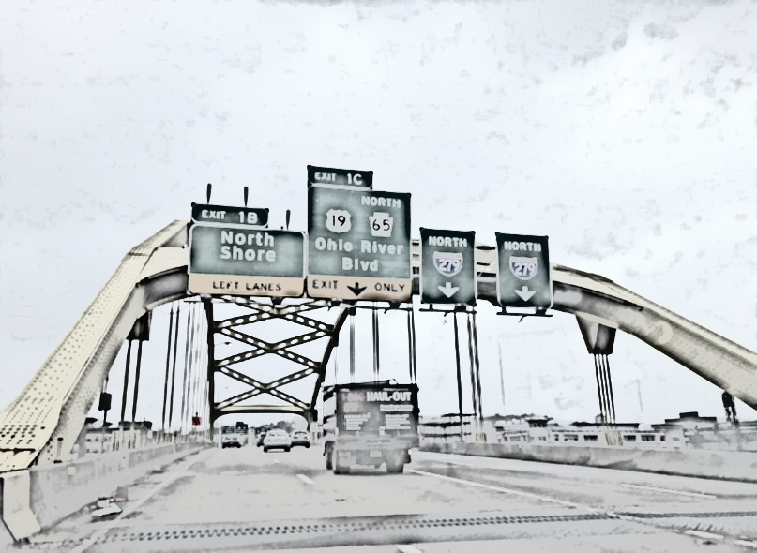
Completed Pitt Research
Bridge
Steel Bridge Corrosion Prevention and Mitigation Strategies, Dr. Stephens
Corrosion Repair Strategies for Steel Girder Ends Using High Performance and Traditional Materials, Dr. Harries
Improving Bridge Assessment Through the Integration of Conventional Visual Inspection, Non-Destructive Evaluation and Structural Health Monitoring Data, Dr. Alavi
Pitt Bridge Condition Assessment System (PittBCAS)
Output delamination area
Output
Crack region density
Total crack length
Crack density
Spall region density

Slide 4
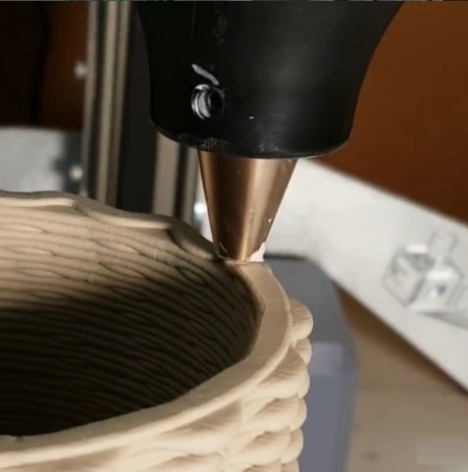
Ongoing Pitt Research
Bridge
Data Management, Mining, and Inference for Bridge Monitoring, Dr. Rizzo
Integrating Additive Manufacturing with Accelerated Bridge Construction Techniques, Dr. Alavi

Slide 5
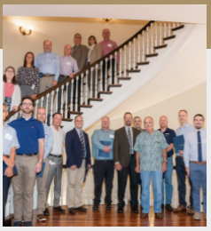
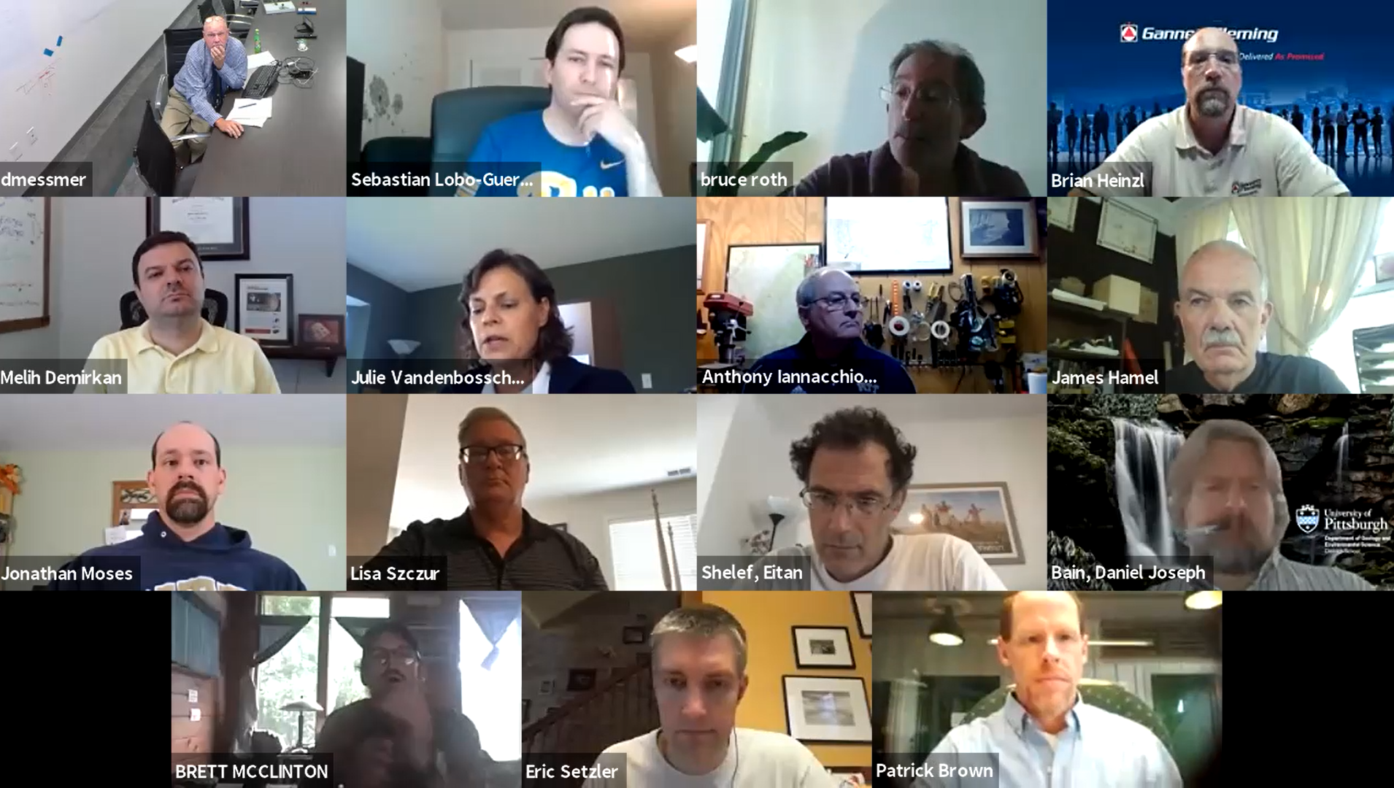
Completed Pitt Research
University of Pittsburgh | Swanson School of Engineering
Geotechnical
Subsidence Impact Forecasting: I-70 over Longwall Mine, Dr. Iannacchione
Exploring Approaches to Managing Landslide Risks:
Workshop Summary Report, Dr. Iannacchione
Landslide Capacity Building Seminars, Drs. Iannacchione and Bain
Depth to Bedrock Seismic Measuring Device, Dr. Sachs

Slide 6
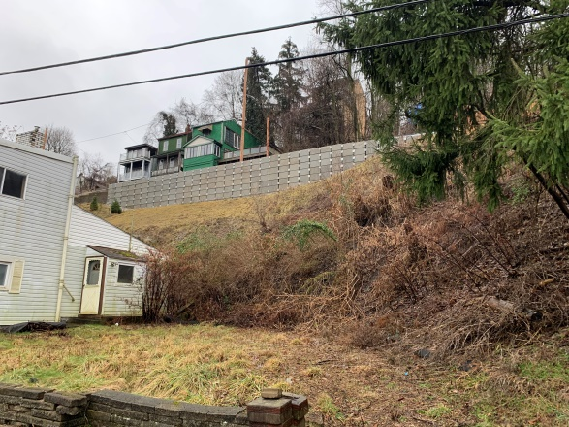
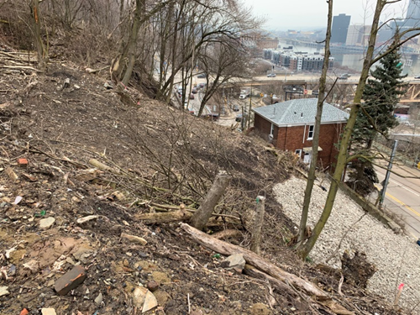
Ongoing Pitt Research
University of Pittsburgh | Swanson School of Engineering
Geotechnical
Landslide Best Practices, Dr. Ciloglu, MBI
Development of a Roadway Landslide Inventory and Analytical Tool for Southwestern Pennsylvania, Drs. Bain, Iannacchione and Shelef

Slide 7
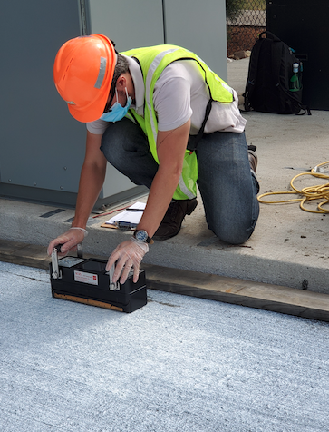
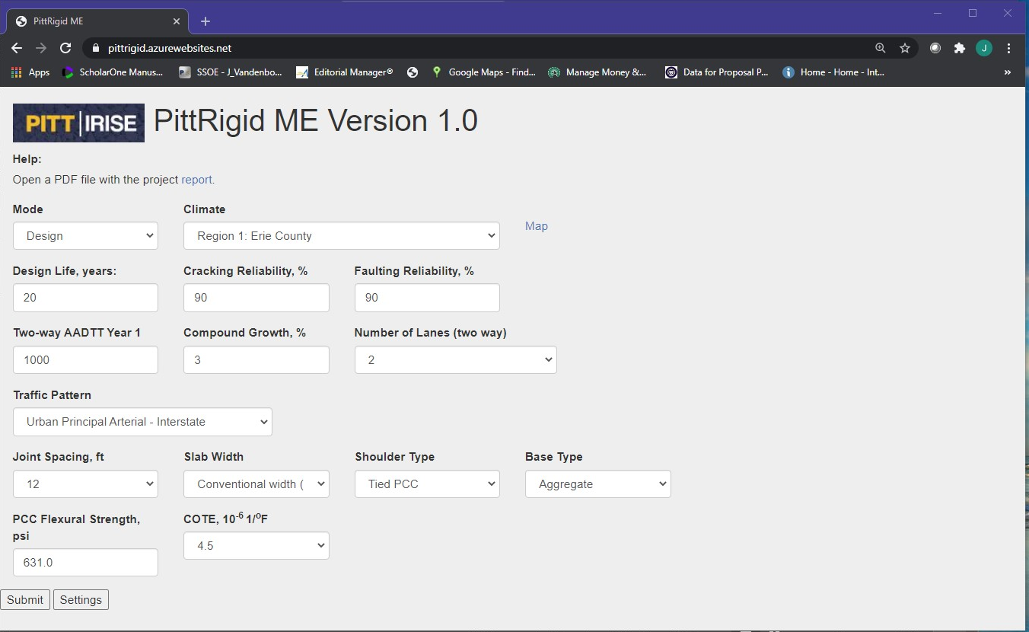
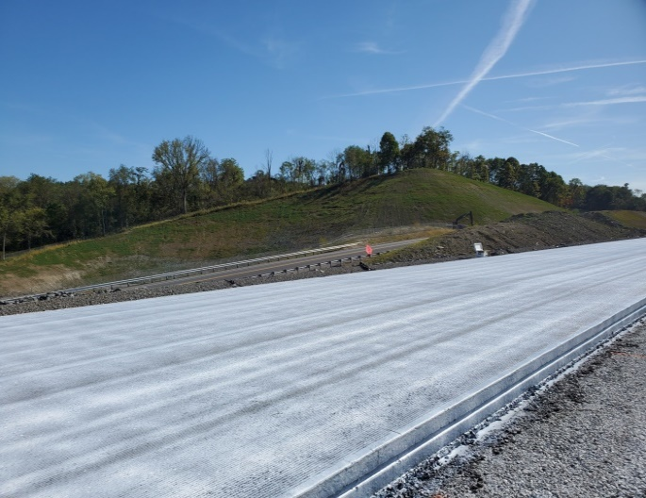
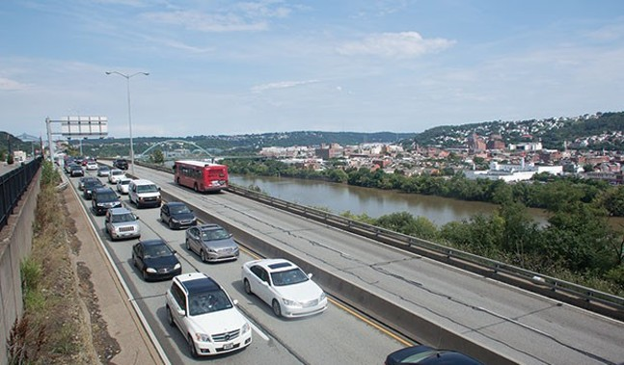
Completed Pitt Research
University of Pittsburgh | Swanson School of Engineering
Pavements
Development of a Simplified Mechanistic-Empirical Design Tool for Rigid Pavements in PA, Dr. Khazanovich
Early Opening of Concrete Pavements to Traffic, Dr. Khazanovich
Effect of Super Loads on Pavement Life, Dr. Vandenbossche
Preliminary Evaluation of Pavement Surface Distresses Related to Pavement Markings, Dr. Khazanovich

Slide 8
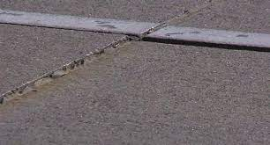
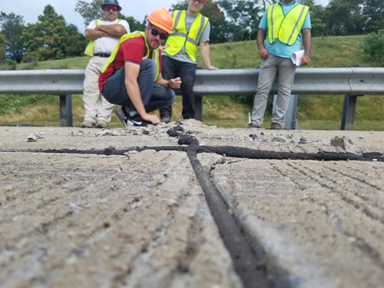
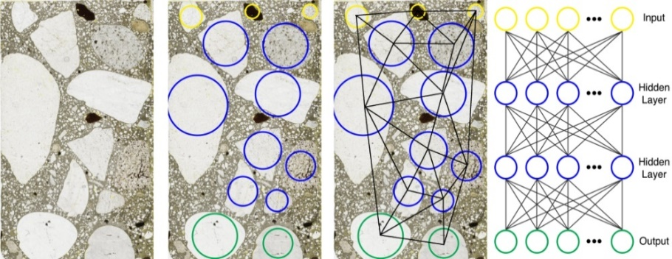
Ongoing Pitt Research
University of Pittsburgh | Swanson School of Engineering
Pavements
Faulting Models for JPCP and BOCA, Drs. Khazanovich (JPCP) Vandenbossche (BCOA)
Three-dimensional Micro-mechanical Characterization of the Effect of Vibration and Compaction in Concrete Pavements, Drs. Fascetti and Vandenbossche
Joint Performance Optimization for JPCP, Dr. Vandenbossche

Slide 9
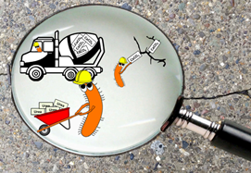
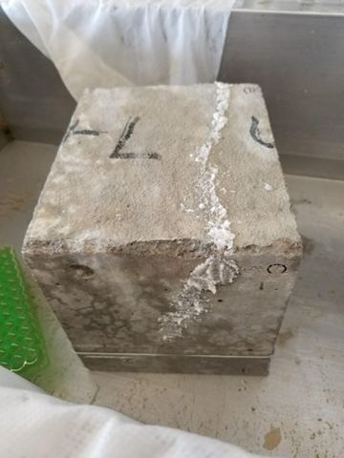
Completed Pitt Research
University of Pittsburgh | Swanson School of Engineering
Materials
Microbial Concrete Sealer for RC, Drs Sachs and Haig
Carbon Nanotube Additives for Structural and Highway Concrete,
Drs Sachs and Gilbertson
Material Compatible Repairs for Concrete Pavements and Bridge
Decks, Drs. Sachs and Vandenbossche
FAILURE

Slide 10
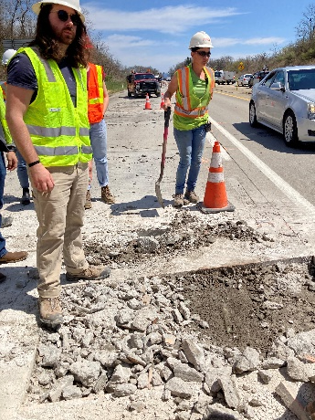
Ongoing Pitt Research
University of Pittsburgh | Swanson School of Engineering
Materials
Material Compatible Repairs Evaluation, Drs. Sachs, Khazanovich and Vandenbossche
Carbon Nanotube Additives for Structural and Highway Concrete (Continuation),
Drs. Sachs and Gilbertson
Microbial Concrete Sealer (Continuation),
Drs. Sachs and Haig

Slide 11
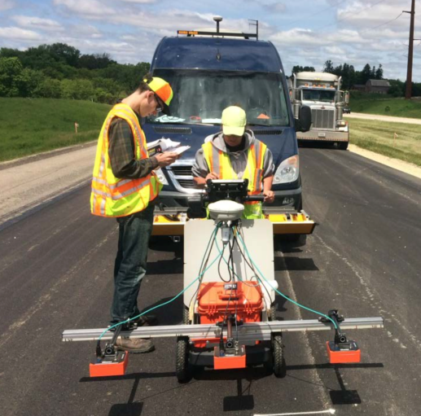
Completed Pitt Research
University of Pittsburgh | Swanson School of Engineering
Workers Safety
Remote Controlled Technology
Assessment for Safer Pavement Construction
and QA/QC, Drs. Khazanovich

Slide 12
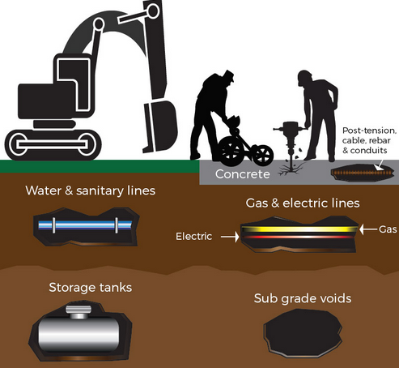
Ongoing Pitt Research
University of Pittsburgh | Swanson School of Engineering
Investigating New Underground Utility Location Technologies and Novel Methods to Improve the Safety and Efficiency of Highway Construction, Dr. Khazanovich
Identifying Major Causes of Construction Accidents for the Paving Industry in Pennsylvania, Dr. Khazanovich
Workers Safety

Slide 13
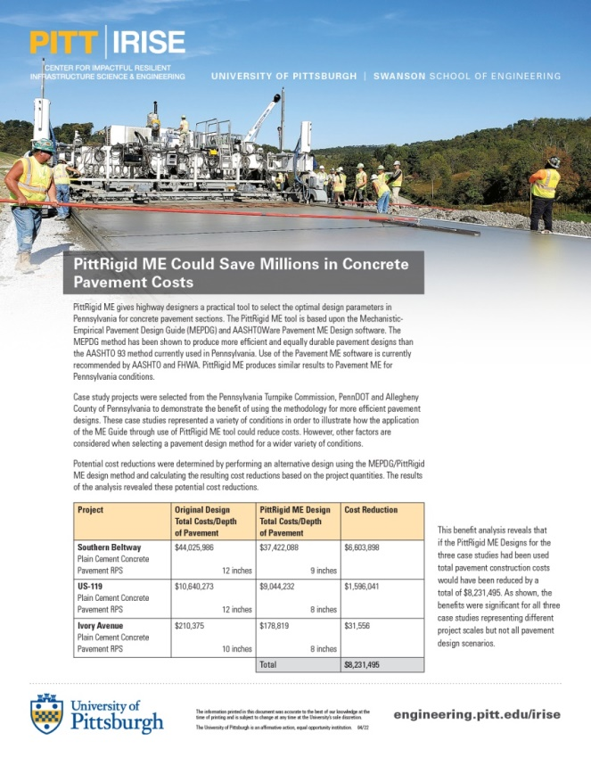
Ongoing Pitt Research
University of Pittsburgh | Swanson School of Engineering
Other
Developing Methodologies to Predict and Quantify the Benefits of IRISE Research, Dr. Magalotti
Tactical Urbanism/Demonstration Projects Guide, Dr. Stevanovic

Slide 14
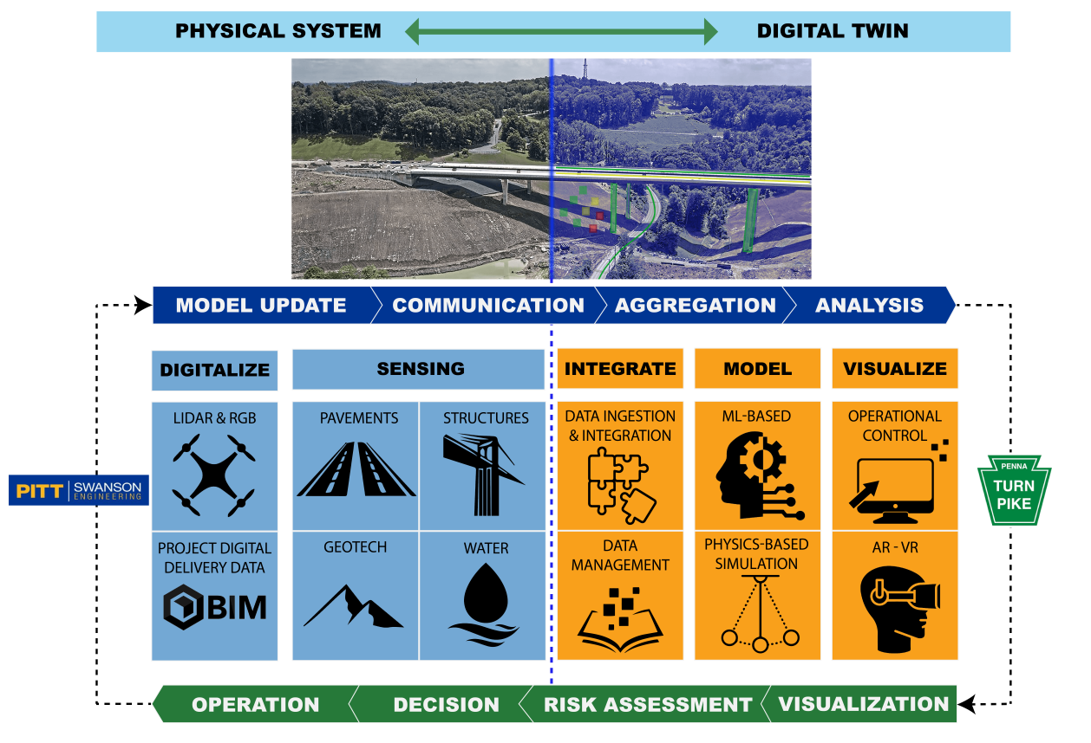
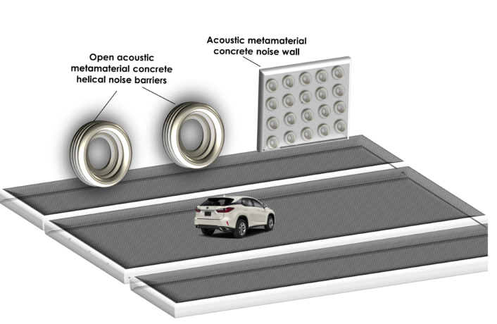
Mon Fayette Expressway Test Bed
University of Pittsburgh | Swanson School of Engineering
Absorptive Sound Walls: Dr. Alavi
Digital Twin Technology: Dr. Fascetti
Electrified Roadway Strategic Plan: Dr. Alavi
Energy Harvesting: Dr. Alavi

Slide 15
IRISE Year 5 Projects Being Initiated
University of Pittsburgh | Swanson School of Engineering
Bridge: Methodology for Structural Optimization of Bridge Decks Against Corrosion, Dr. Brigham
Geotechnical: Seminar Series on Innovative and Comprehensive Stormwater Management, Dr. Bain
Pavement: Design and Construction of Two-lift Concrete Pavements for Pennsylvania, Dr. Khazanovich
Pavement: Prediction of Dowel Corrosion and Effect on Performance of Concrete Pavements, Dr. Vandenbossche
Pavement: Seal Coat for Asphalt Pavements: Best Practices and Experience, Dr. Dave
Materials: Developing Light-Weight and High-Performance Metamaterial Concrete, Dr. Alavi
Worker Safety: Immersive VR Platform for H&S Training of Construction Workers, Dr. Fascetti

Slide 16
Bridge: Methodology for Structural Optimization of Bridge Decks Against Corrosion
University of Pittsburgh | Swanson School of Engineering
Bridge
Problem: Need to quantitatively assess the technical and economic benefits associated with different corrosion mitigation strategies
Approach:
Produce quantitative measures of the effectiveness of combining different mitigation strategies in terms of extended life-span and reduced corrosion rates
Develop practical guidelines for the optimal design and adoption of corrosion-resistant measures
Drs. Brigham and Fascetti
Duration: 24-months

Slide 17
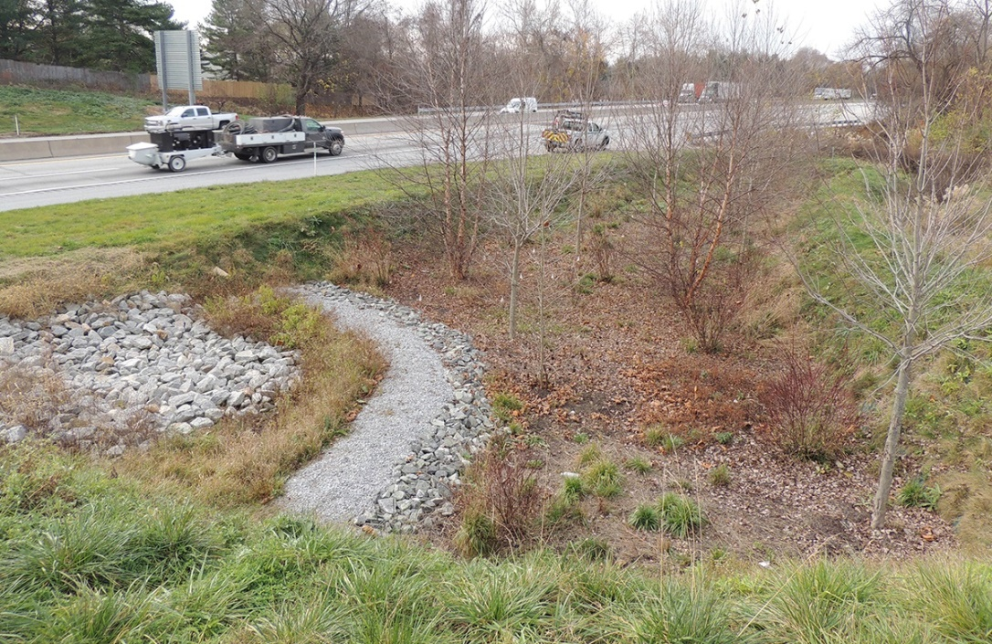
Seminar Series on Innovative and Comprehensive Stormwater Management
University of Pittsburgh | Swanson School of Engineering
Stormwater
Problem: Need to better coordinate regional stormwater management
Approach: Conduct a series of seminars similar to the successful Landslide Capacity Building seminars:
Broad participation including students
Focus on sub-topic at each seminar
Drs. Bain and Shelef
Duration: 12-months

Slide 18
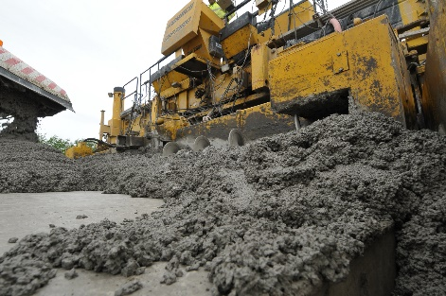
Design and Construction of Two-lift Concrete Pavements for Pennsylvania
University of Pittsburgh | Swanson School of Engineering
Pavements
Problem: Use of high-quality concrete at the bottom of a design is unnecessary and environmentally unfriendly
Approach:
Laboratory testing of different mixes
Design guidelines and section design
Construction and assessment
Drs. Khazanovich and Vandenbossche
Duration: 24-months

Slide 19
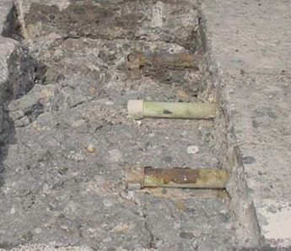
Quantifying the Effect of Dowel Corrosion on Performance of Concrete Pavements
University of Pittsburgh | Swanson School of Engineering
Pavements
Problem:
Dowel corrosion leads to decreased long-term performance of jointed concrete pavements.
Long term dowel corrosion resistance not well understood.
Approach:
Identification of critical factors through modeling
Accelerate laboratory testing
Development of prediction models
Development of design guidelines
Dr. Vandenbossche
Duration: 24-months

Slide 20
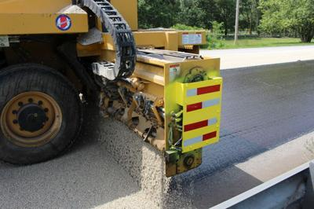
Seal Coat for Asphalt Pavements: Best Practices and Experience
University of Pittsburgh | Swanson School of Engineering
Pavements
Problem: Variability in seal coat performance reported by State DOTs
Approach:
Collect and analyze best practices from DOTs and contractors, including design, construction and inspection
Collect current practice information from IRISE members
Compare and develop recommendations
Dr. Dave (University of New Hampshire)
Duration: 14-months

Slide 21
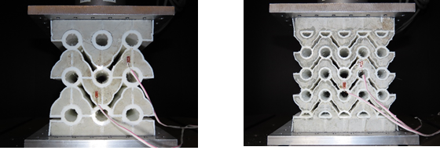
Developing Light-Weight and High-Performance Metamaterial Concrete
University of Pittsburgh | Swanson School of Engineering
Materials
Problem: Challenge in developing light-weight concrete (LWC) with low density and high strength
Approach:
3D print a range of metamaterial lattices
Conduct experimental studies to evaluate the properties of LWC beams and cubes reinforced by the metamaterial lattices
Develop recommendations
Dr. Alavi
Duration: 24-months

Slide 22
Immersive VR Platform for H&S Training of Construction Workers
University of Pittsburgh | Swanson School of Engineering
Workers Safety
Problem: Need for better and more frequent H&S training for construction workers
Approach: Develop an immersive Virtual Reality environment training platform
Digital representation of a construction site
Random insertion of hazards (gaming)
Objective monitoring of learning progress
Drs. Fascetti and Khazanovich
Duration: 24-months

Slide 23
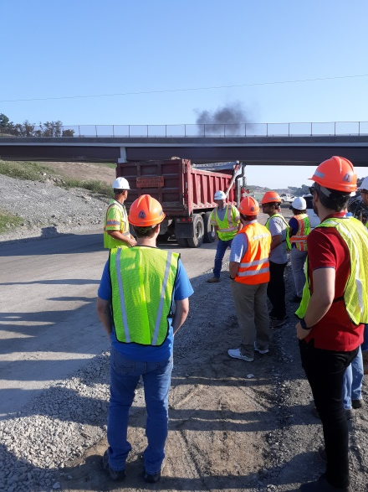
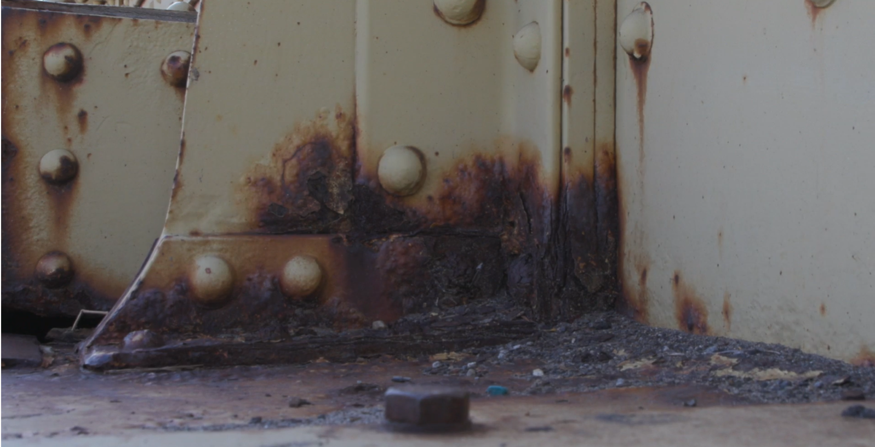
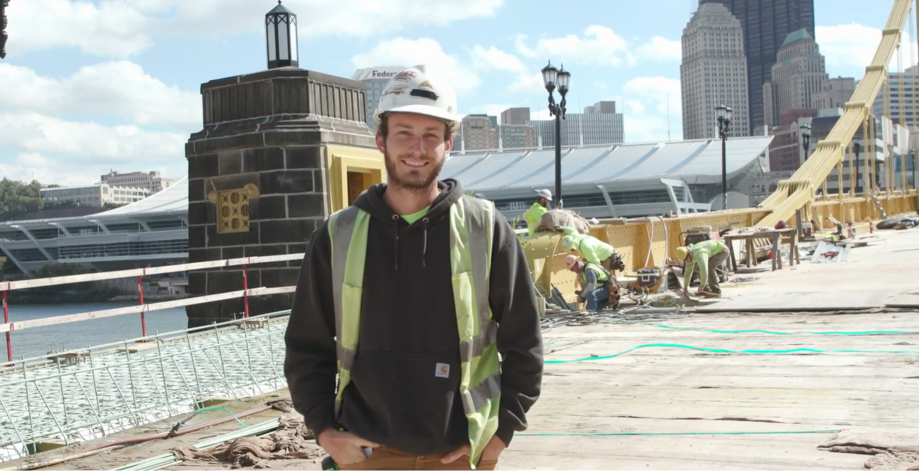
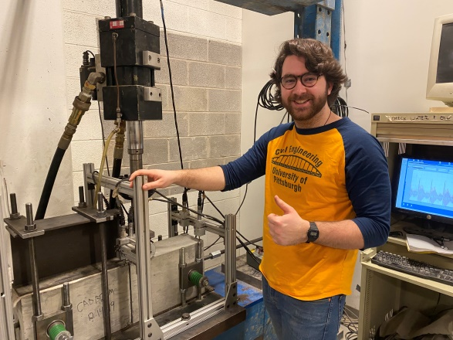
Other Activities
University of Pittsburgh | Swanson School of Engineering
Student involvement
Workshops/seminars
Demonstration projects
Tech days
Presentations to help tech deployment
Other ideas ????
Three Sisters Bridges – Allegheny Cnty
https://www.engineering.pitt.edu/irise

