Slide 1

Review of Steel Bridge Corrosion prevention, mitigation and rehabilitation strategems
Max T. Stephens, Ph.D. (CEE)
Brian Gleeson, Ph.D. (MEMS)
Bingtao Li, Ph.D. (MEMS)
Jason Mash, Ph.D. (CEE)
University of Pittsburgh | Swanson School of Engineering

Slide 2
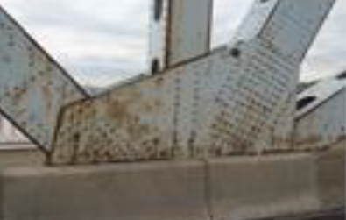
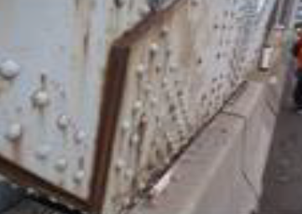
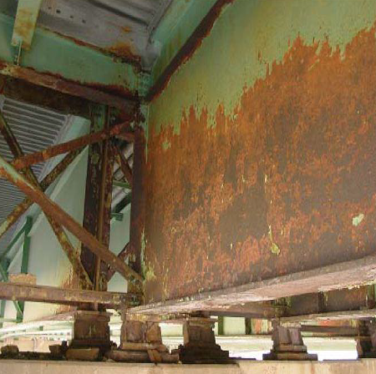
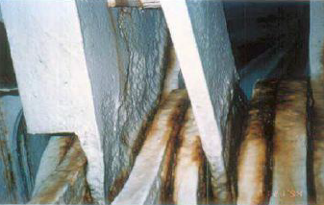
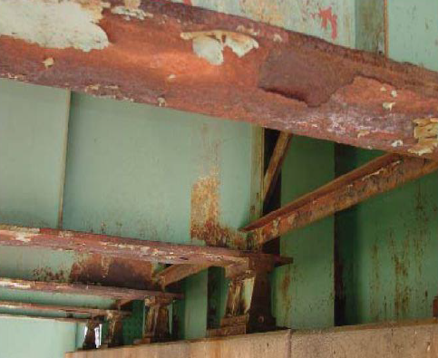
The problem
Corrosion is a primary cause of structural deficiencies in Pennsylvania bridges
Crevice Corrosion – Elizabeth Bridge¹
Pitting/Crevice Corrosion – Hulton Bridge¹
Deposit Attack– Birmingham Bridge¹
University of Pittsburgh | Swanson School of Engineering

Slide 3
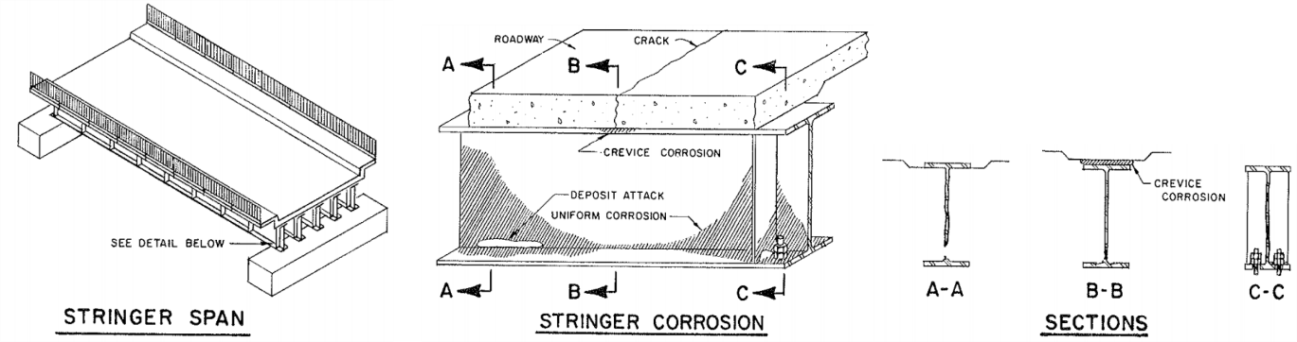
The problem
Corrosion in Stringer Span Bridges²
University of Pittsburgh | Swanson School of Engineering

Slide 4
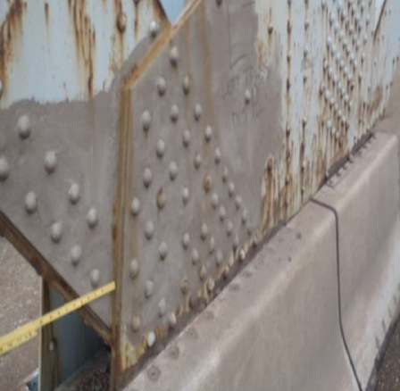
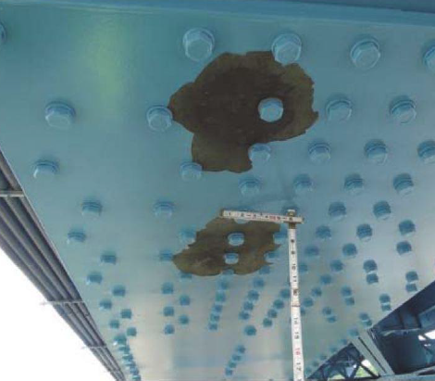
The problem
Traditional corrosion prevention/mitigation/ rehabilitation strategies are costly
Proprietary “miracle cures” are not always effective
Rust Bleeding through Termarust –
Elizabeth Bridge¹
Amine Blush – 31st Street Bridge¹
University of Pittsburgh | Swanson School of Engineering

Slide 5
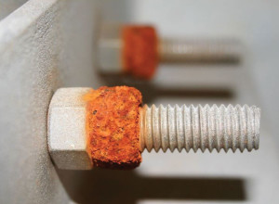
Research objectives
To provide an overview of corrosion prevention/ mitigation/rehabilitation approaches based on a review of relevant literature
To identify possible strategies which differ from the state-of-practice in PA for implementation and/or future study
Obvious case - Don’t connect dis-similar
Metals unless you want galvanic
corrosion²
University of Pittsburgh | Swanson School of Engineering
5

Slide 6
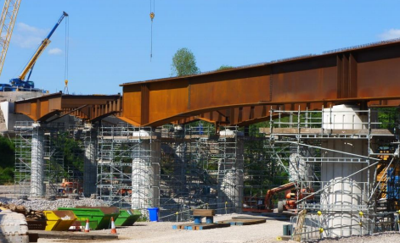
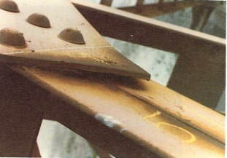
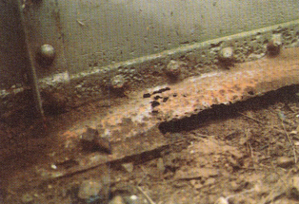
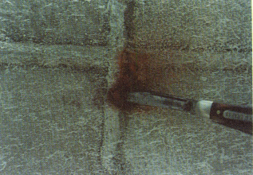
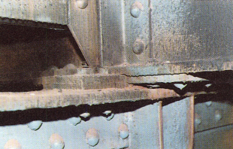
Approach - tasks
Identify corrosion patterns in steel bridges
Uniform Corrosion²
Galvanic Corrosion²
Crevice Corrosion²
Pitting Corrosion²
Weld Decay²
Fretting Corrosion²
University of Pittsburgh | Swanson School of Engineering

Slide 7
Approach - tasks
Identify the state-of-practice in corrosion prevention/mitigation/rehabilitation (both in Pennsylvania and beyond)
Better paints
Duplex coatings
Galvanizing
Metalizing (Zn/Al or Al)
Weather steel / stainless steel
Lead containing alkyd paint,
Currently in half of bridges,
Need to repaint
Three coat paint:
Zinc primer-epoxy midcoat-Polyurethane topcoat
1970s
Gold Standard
1990s
2019
Zinc-based coat:
Zinc paint,
Galvanizing,
Metallizing
Two coat paint:
Zinc primer + polyaspartic (PAS) topcoat
University of Pittsburgh | Swanson School of Engineering

Slide 8
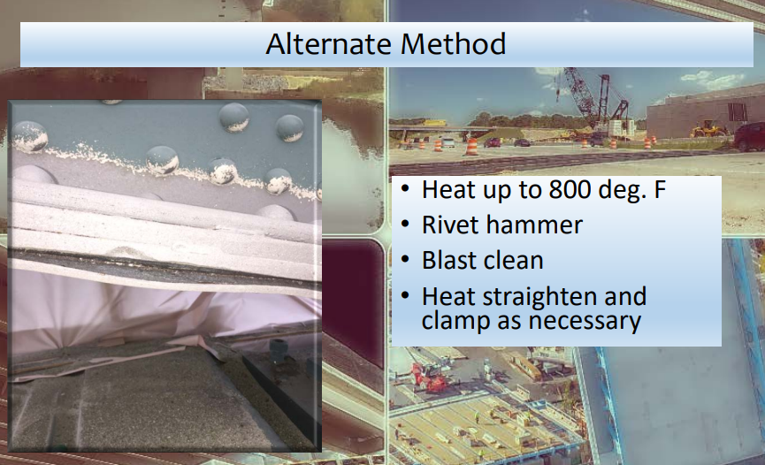
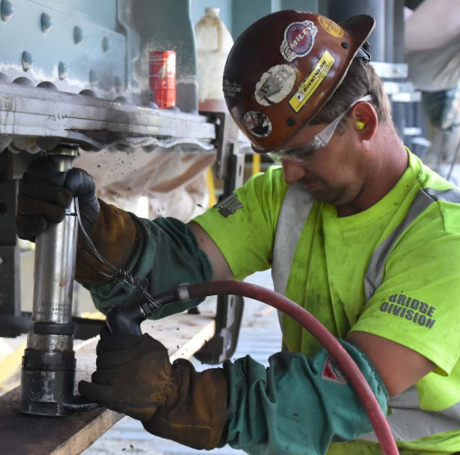
Approach - tasks
Identify state-of-the-art in corrosion prevention/mitigation/rehabilitation
Michigan DOT Pack Rust Removal Method³
University of Pittsburgh | Swanson School of Engineering

Slide 9
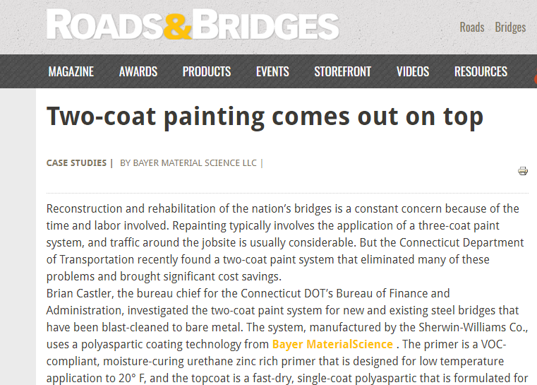
Approach - tasks
Identify state-of-the-art in corrosion prevention/mitigation/rehabilitation
Connecticut DOT investigates two-coat paint system⁴
University of Pittsburgh | Swanson School of Engineering

Slide 10
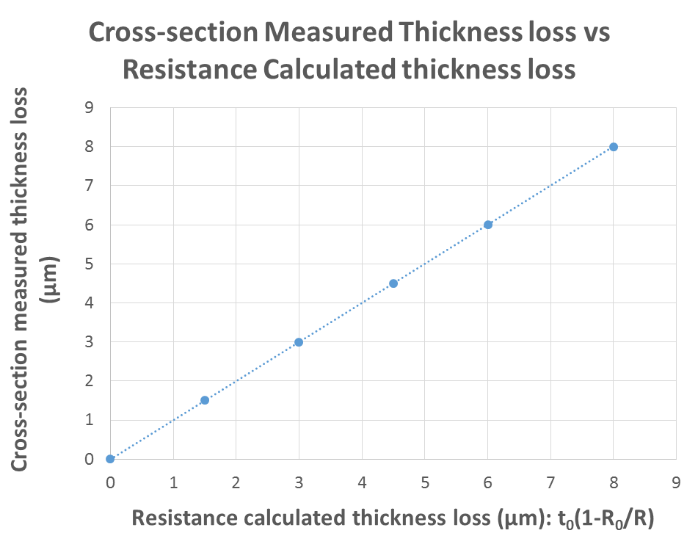
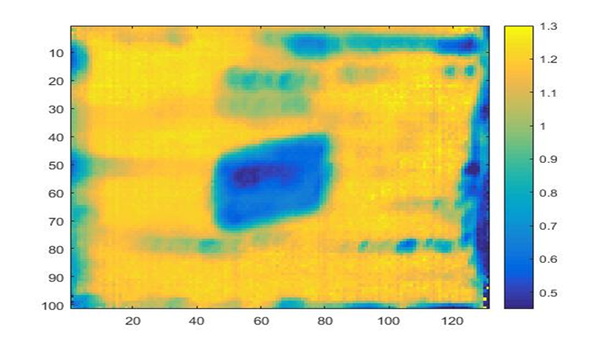
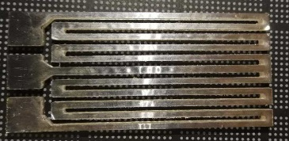
Approach - tasks
Identify state-of-the-art in corrosion prevention/mitigation/rehabilitation
Sensor for corrosion monitoring
IR for quantifying corrosion extent
University of Pittsburgh | Swanson School of Engineering

Slide 11
Approach - tasks
Recommend corrosion prevention/mitigation/ rehabilitation strategies for implementation and/or future study
Environmental Regulations
E
Coating Performance
P
H
Health Protection
innovation
S
C
Cost Reduction
Sustainability
University of Pittsburgh | Swanson School of Engineering

Slide 12

schedule
Months | 1 | 2 | 3 | 4 | 5 | 6
Task 1: Identify common corrosion patterns
Task 2: Identify corrosion prevention strategies
Task 3: Identify corrosion mitigation strategies
Task 4: Identify corrosion rehabilitation strategies
Task 5: Identify prevention/mitigation/ rehab strategies for use in PA
Draft Final Report
Deliverable 1: Final Report
University of Pittsburgh | Swanson School of Engineering

Slide 13
Application of research product
To identify corrosion prevention/mitigation/ rehabilitation strategies which differ from the state-of-practice in Pennsylvania for implementation and/or future study for use on Pennsylvania bridges
University of Pittsburgh | Swanson School of Engineering
13

Slide 14
references
Ruzzi, L.J. Painting Projects in PennDOT District 11. Presentation at the 2014 National Bridge Preservation Conference. Orlando, FL. April 23rd, 2014.
J. M. Kulicki, Z. Prucz, D. F. Sorgenfrei, D. R. Mertz, and W. T. Young, “Guidelines for Evaluating Corrosion Effects in Existing Steel Bridges,” National Cooperative Highway Research Program, NCHRP 333, 1990.
Curtis, R. Bridge Development Update. Presentation at the Michigan Bridge Conference, 2017.
Olson, A. Williams, T., Hudson, M, and Fleming, D.W. Steel Bridges Protected with Two-Coat Polyaspartic Urethane Coatings. Materials Performance Magazine, 2017.
University of Pittsburgh | Swanson School of Engineering
14

Slide 15
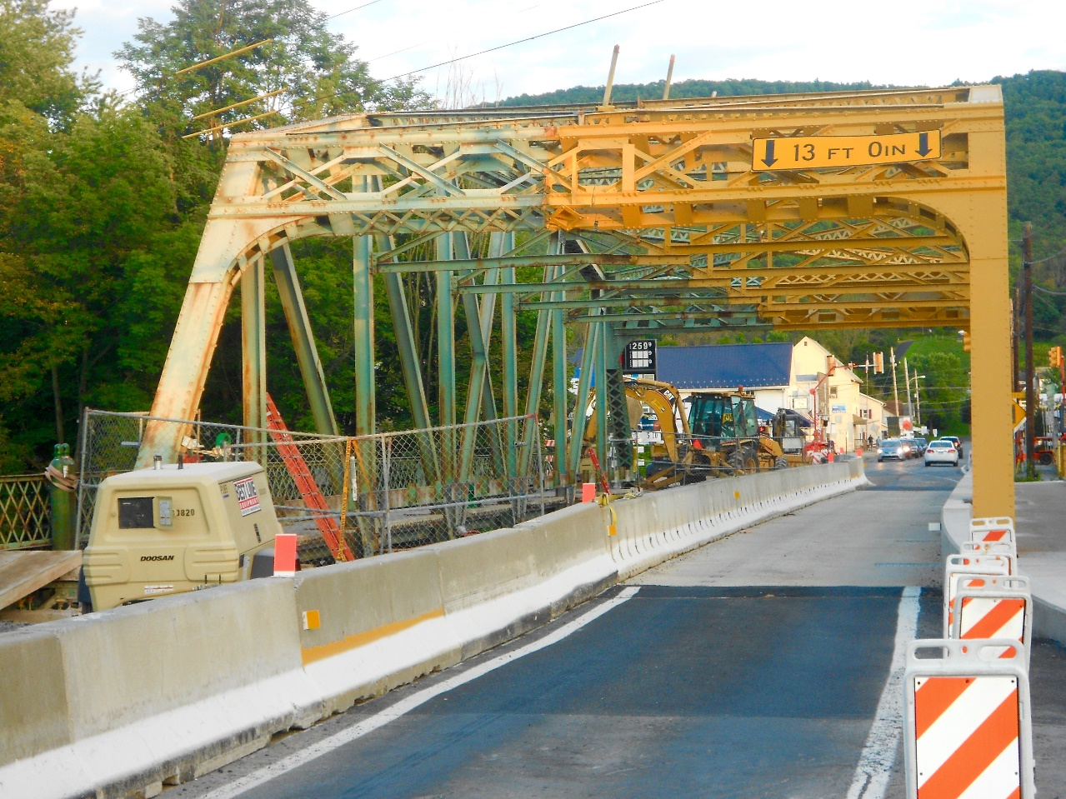
Thank you
max.stephens@pitt.edu
University of Pittsburgh | Swanson School of Engineering
15

