Slide 1
MEPDG – Pavement Design
Julie M. Vandenbossche, P.E., Ph.D.
University of Pittsburgh
Transportation Forum
-Infrastructure Renewal in Transportation-
March 23,2013

Slide 2
Current status of roadways

Slide 3
Current status of PA roadways

Slide 4
Current status of PA roadways
57% of Pennsylvania’s roads are in poor or mediocre condition.

Slide 5
Current status of PA roadways
Driving on roads in need of repair costs Pennsylvania motorists $2.947 billion a year in extra vehicle repairs.

Slide 6
Current status of roadways

Slide 7
Current status of roadways
Federal, state, and local = $91 billion annually
“…level of investment is insufficient and still projected to result in a decline in conditions and performance ….”
FHWA estimates $170 billion needed annually to significantly improve conditions and performance.

Slide 8
Current design method-DARWIN
INPUTS
Slab thickness
k-value
ESAL
Reliability
PCC strength & stiffness
STATISTICAL
REGRESSION
MODEL
OUTPUT
Δ PSI
www.pavementinteractive.org

Slide 9
Current design method-DARWIN
INPUTS
Slab thickness
k-value
ESAL
Reliability
PCC strength & stiffness
STATISTICAL
REGRESSION
MODEL
OUTPUT
Δ PSI
www.pavementinteractive.org

Slide 10
Current design method-DARWIN
INPUTS
Slab thickness
k-value
ESAL
Reliability
PCC strength & stiffness
Based on materials and traffic conditions from
1958-1960
STATISTICAL
REGRESSION
MODEL
OUTPUT
Δ PSI
www.pavementinteractive.org

Slide 11
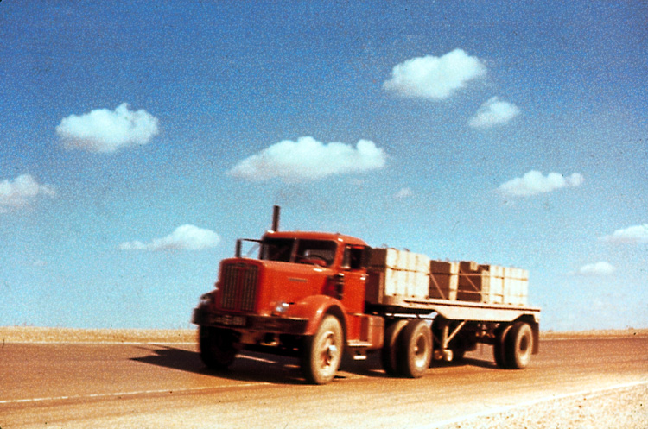
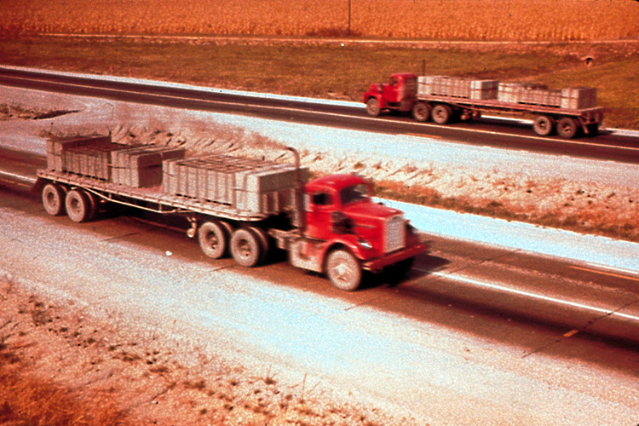
AASHO Test Traffic
Max Single Axle
Max Tandem Axle
Notes:
This is a pictures of the maximum single and tandem axles. The drivers were army recruits who spent the entire time driving in circles. Note, there was not any air-conditioning, nor radios
Trucks were supposed to keep an average speed of 35 mph . There were also supposed to be painted white line in the road that they were supposed to stay on.

Slide 12
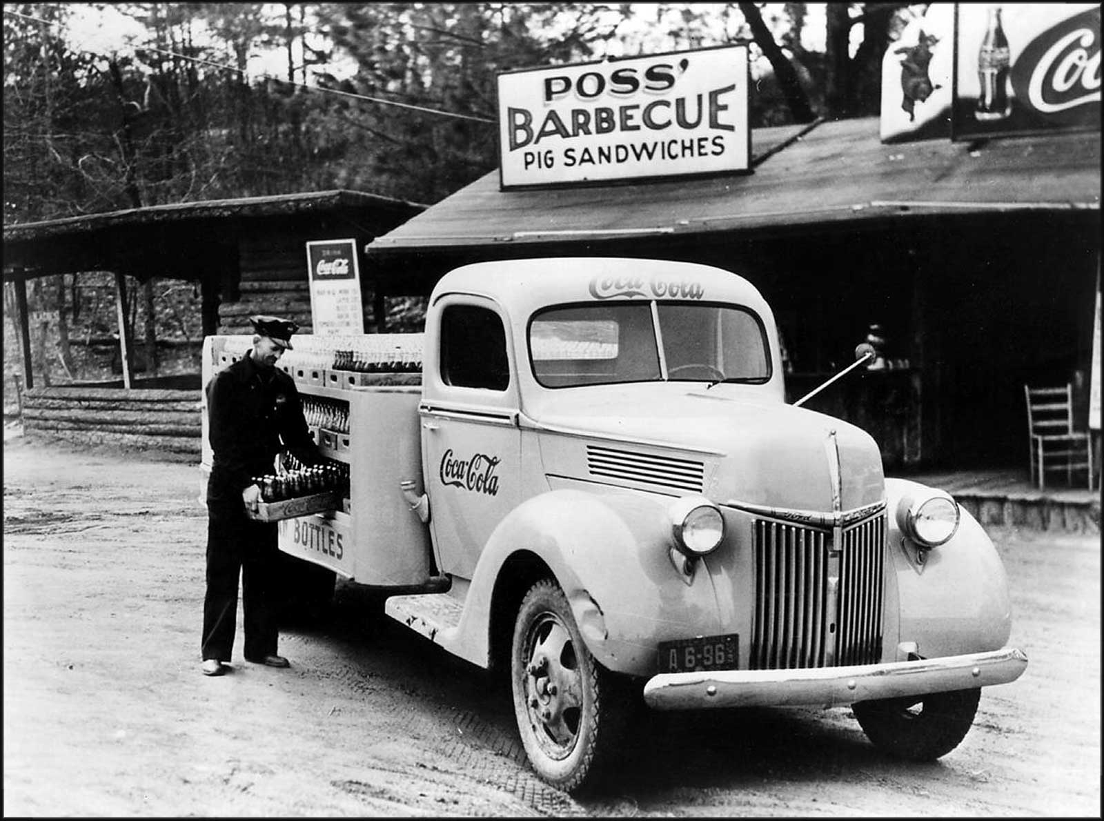
Current traffic stream
Refrigerated Volvohttp://autos.kosmix.com/topic/Semi-trailer_truck

Slide 13
AASHO Test Traffic
Started Nov. 1958
Loops 3-6:
6 veh/lane
10 veh/lane (Jan ‘60)
Operation
18 hr. 40 min.
6 days/wk
Total Loads
1,114,000 Applications
Avg. ESAL - 6.2 million
Max ESAL - 10 million (Flex)
Notes:
This shows the typical test traffic on the pavement test sections. All test vehicles were trucks. The single axles loads ranged from 900 kg to 13,600 kg (2,000 - 30,000 lbs.); tandem axles loads ranged from 10,890 kg to 21,780 kg (24,000 to 48,000 lbs.). It is important to note that front axles were not considered load axles except in loop 2, lane 1.
Traffic ran on the test loops from November 1958 to December 1960 (25 months). The test vehicles operated for 18 hr. 40 min. per day for 6 days a week. The average speed on the test loops was maintained at approximately 56 km/hr (35 mph). In total, there were 1,114,000 load applications during the 25 months of testing with over 27 million km (17 million miles) driven.

Slide 14
AASHO Loading Limitations
Current design traffic is far beyond road
test limits
Data Limits
(AASHO Road Test)
Projection B
Projection C
Pavement Thickness
Projection A
•
Current
Designs
>100 Million
•
•
•
•
•
•
<2 Million
Axle Load Repetitions
Notes:
Key Message: We are extending the findings of the AASHO road test data well beyond anything they imagined.
Background Information: This slide demonstrates one of the most serious drawbacks to using the AASHO road test as a basis for the pavement design. The AASHO road test data was based upon less than 2 million axle applications. This information can be projected several different ways as illustrated by Projection A straight line (the increase in traffic gets a proportional increases in thickness). Or by Projection B, that say as the traffic increase the required thickness required increases at a substantial greater rate. Or Projection C, that says the thickness requirement vary with different levels of traffic. Now we design some roads approaching 100 million applications. The bottom line is that we are way beyond the traffic limits in the AASHO road test.
Instructor Notes: Which of these projections is right based upon the road test? [Make sure you wait until someone tries to answer.]

Slide 15
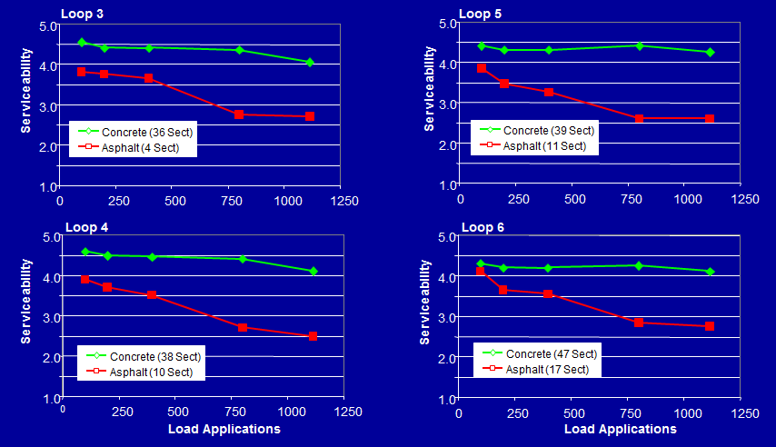
AASHO road test performance

Slide 16
AASHO road test performance
85% of the PCC pavement sections were not loaded to failure.

Slide 17
Materials and design features
Superpave
Finer cements
Lower w/c
Stabilized bases
Select granular fill
1.5 in dowels
Edge drains
Etc….

Slide 18
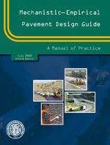
New design method - MEPDG
www.darwinme.org

Slide 19
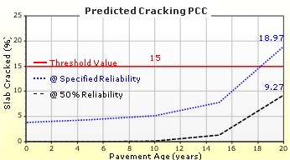
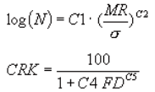
New design method - MEPDG
Over 100 INPUTS
Pavement structure
Characterize
Axle Loads and Volumes
Temporal material properties
Climate
STRUCTURAL
MODEL
FATIGUE DAMAGE MODEL
Stress & Deflection
Accumulate damage
OUTPUTS
Cracking
Faulting
IRI
TRANSFER FUNCTION
Correlate damage to distress

Slide 20
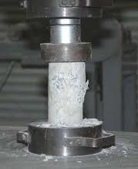
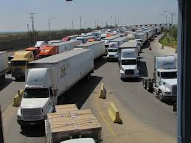
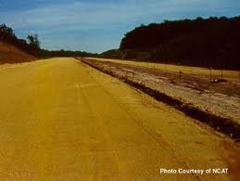
MEPDG
Time
increment
PCC Strength
www.frankoverstreet.com
CTE
www.fronterasdesk.org
Traffic
barkleydevelopmentcompany.net
No Units
Base
Modulus
Subgrade
Modulus
0
2
4
6
8
Time, years
Applied Research Associates
Notes:
This is a good point to bring back this slide to show how the model through the use of the traffic, climate and material models has considered the changing values of each of the parameters.

Slide 21
Implementation: Benefits
Improved confidence in design
More cost-effective designs
Special analysis capabilities
Extrapolation for unusual designs
Complicated rehab designs
Identify problems with existing designs
Forensic analyses
Special loadings
Notes:
Key message: These are some of the potential Benefits of MEPDG Implementation.
Background Information: Improved confidence in the chosen design is a result of using: 1) calibrated models representative of local conditions, 2) material and traffic inputs representative of specific project conditions, and 3) local climate at user defined reliability parameters. With these factors generating designs based on sound engineering principles, agencies can have greater confidence in the chosen design functioning as expected (i.e., lasting for the prescribed life-span).
Cost effective designs will be achieved as a result of fewer over- or under-designs.
Probably the greatest benefit is the flexibility to consider special analyses. Forensic studies, such as evaluation of changes in features from the original design and their impact on distress predictions, can be performed easily. Special loading conditions can be modeled to consider impact on performance. In addition to those listed on this slide, the MEPDG accommodates defensible specification limits and pay factors, since changes in material properties or construction conditions can be evaluated immediately to determine anticipated impact on performance. The user has a great deal of flexibility in using the MEPDG for a variety of studies and evaluations.
Instructor Notes: Build Slide – Ask participants what they believe are possible benefits to implementation. Then go through those already identified and review them with the participants. See if this prompts other ideas and add them to the whiteboard list.

Slide 22
Agency implementation options
Central office
Districts
Multilevel adoption
Design catalogues (developed using MEPDG)
Most roadways:
MEPDG designs
High volume roadways
Non-standard materials/pave. design features
Notes:
Key Message: Step 3 covers Development of the Database to define local conditions, which is required for calibration and validation of the models in the MEPDG.
Background Information: As discussed in Lesson 6.1, development of a database that catalogues the range of conditions in an agency will be a key component in the calibration and validation of the models in the MEPDG. The data set may be composed of two distinct types of information. For short term, or “immediate” needs, section information for existing, in-service conditions can be documented, using estimates of material properties or conditions where necessary to fill out the data set. The key to this will be the availability of time series performance data to compare to MEPDG predictions over time. If time-series data collection exists, then efforts should be made to use these sections to validate the model predictions.
In addition, new sections may be monitored, allowing the agency to define all MEPDG input parameters at the onset of the performance monitoring period. This will require a long term commitment to this effort, but is the only true way to calibrate the models to local conditions.
Consideration may be given to use of accelerated pavement testing methods as a means of calibrating the MEPDG as well. Data from an accelerated loading facility or test track may be used to compare actual to predicted performance very quickly. This allows the controlled testing of a pavement section and determination of the material properties for validation in a relatively short period of time. Caution will have to be used to ensure that the results from accelerated testing are representative of true field performance. Accelerated pavement testing provides one alternative for short term results.

Slide 23
Implementation
Over 100 INPUTS
Pavement structure
Characterize
Axle Loads and Volumes
Temporal material properties
Climate
STRUCTURAL
MODEL
FATIGUE DAMAGE MODEL
Stress & Deflection
Accumulate damage
OUTPUTS
Cracking
Faulting
IRI
TRANSFER FUNCTION
Correlate damage to distress

Slide 24
Implementation
Over 100 INPUTS
Pavement structure
Characterize
Axle Loads and Volumes
Temporal material properties
Climate
STRUCTURAL
MODEL
FATIGUE DAMAGE MODEL
Stress & Deflection
Accumulate damage
OUTPUTS
Cracking
Faulting
IRI
TRANSFER FUNCTION
Correlate damage to distress

Slide 25
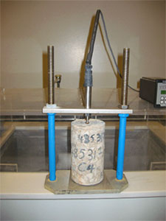
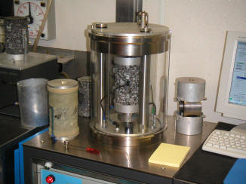
Implementation process 1. Database development
Materials
Surface, base, subbase and subgrade
Determine default properties
Notes:
Key Message: Step 3 covers Development of the Database to define local conditions, which is required for calibration and validation of the models in the MEPDG.
Background Information: As discussed in Lesson 6.1, development of a database that catalogues the range of conditions in an agency will be a key component in the calibration and validation of the models in the MEPDG. The data set may be composed of two distinct types of information. For short term, or “immediate” needs, section information for existing, in-service conditions can be documented, using estimates of material properties or conditions where necessary to fill out the data set. The key to this will be the availability of time series performance data to compare to MEPDG predictions over time. If time-series data collection exists, then efforts should be made to use these sections to validate the model predictions.
In addition, new sections may be monitored, allowing the agency to define all MEPDG input parameters at the onset of the performance monitoring period. This will require a long term commitment to this effort, but is the only true way to calibrate the models to local conditions.
Consideration may be given to use of accelerated pavement testing methods as a means of calibrating the MEPDG as well. Data from an accelerated loading facility or test track may be used to compare actual to predicted performance very quickly. This allows the controlled testing of a pavement section and determination of the material properties for validation in a relatively short period of time. Caution will have to be used to ensure that the results from accelerated testing are representative of true field performance. Accelerated pavement testing provides one alternative for short term results.

Slide 26
Implementation process 1. Database development
Concrete material properties (WO #13 Sensitivity analysis)
CTE: (WO#13 & LTPP)
Define for each quarry/pit (Needed)
Strength/Stiffness: (WO#13)
Strength/stiffness at 1, 3, 7, 28 and 90 days
Drying shrinkage (WO#13 & WO#6)
Irreversible (Needed)
Reversible (Needed)

Slide 27
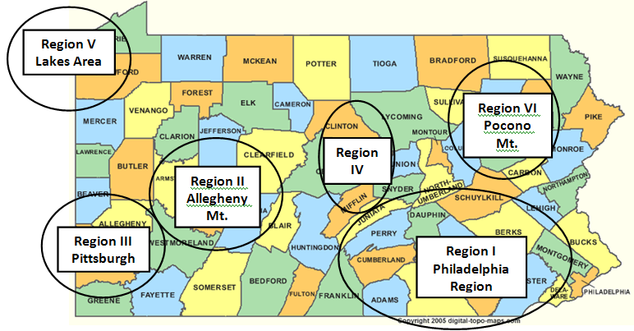
Implementation process 1. Database development
Built-in Gradient for 5 regions:

Slide 28
Implementation process 1. Database development
University of Pittsburgh WO#13
Built-in Gradient for 5 regions:
Month of Construction/ Climatic Region | March | April | May | July | Sep. | Oct. | Nov.
Region I | -1.0 | -0.5 | -0.3 | 0.3 | 0.6 | 0.5 | 0.3
Region II | -1.3 | -0.9 | -0.3 | 0.1 | 0.5 | 0.3 | 0.0
Region III | -1.2 | -0.7 | -0.3 | 0.0 | 0.6 | 0.5 | 0.1
Region IV | -1.0 | -0.6 | -0.1 | 0.3 | 0.6 | 0.5 | 0.1
Region V | -1.3 | -1.0 | -0.6 | 0.0 | 0.5 | 0.4 | 0.0

Slide 29
Implementation 1. Database development (cont.)
Traffic (WO #13)
10 WIM/AVC:
AADTT
Vehicle class distribution
Hourly distribution factors
Axle/load distribution factors
Default values represent WIM data
Notes:
Key Message: Step 3 covers Development of the Database to define local conditions, which is required for calibration and validation of the models in the MEPDG.
Background Information: As discussed in Lesson 6.1, development of a database that catalogues the range of conditions in an agency will be a key component in the calibration and validation of the models in the MEPDG. The data set may be composed of two distinct types of information. For short term, or “immediate” needs, section information for existing, in-service conditions can be documented, using estimates of material properties or conditions where necessary to fill out the data set. The key to this will be the availability of time series performance data to compare to MEPDG predictions over time. If time-series data collection exists, then efforts should be made to use these sections to validate the model predictions.
In addition, new sections may be monitored, allowing the agency to define all MEPDG input parameters at the onset of the performance monitoring period. This will require a long term commitment to this effort, but is the only true way to calibrate the models to local conditions.
Consideration may be given to use of accelerated pavement testing methods as a means of calibrating the MEPDG as well. Data from an accelerated loading facility or test track may be used to compare actual to predicted performance very quickly. This allows the controlled testing of a pavement section and determination of the material properties for validation in a relatively short period of time. Caution will have to be used to ensure that the results from accelerated testing are representative of true field performance. Accelerated pavement testing provides one alternative for short term results.

Slide 30
Implementation 1. Database development (cont.)
Traffic: (Needed)
Roadways servicing special industry (such as mining, farming, etc.)
vehicle class distributions
axle load spectra based on the industry the roadway services.

Slide 31
Implementation 1. Database development (cont.)
Climate: (Needed)
Validate climatic databases
23 climatic stations in MEPDG
Compare predicted cracking/faulting

Slide 32
Implementation 1. Database development (cont.)
Distress/Performance
LTPP (Unavailable)
Local test sections (Needed)
Notes:
Key Message: This is a continuation of Step 3, covering development of a database for calibration and validation of the MEPDG Models.
Background Information: As with materials and traffic, proper definition of distress development over time will require a commitment to long term performance monitoring. Existing LTPP test sections may be useful for this purpose. Other studies conducted by agencies in the past may provide valuable information. It is anticipated that there will be limited amounts of information available. The LTPP program was developed because there was a lack of consistent available information of this type.
Studies should seek to record performance of both new and rehabilitated pavement sections. As the pavement infrastructure continues to age, agencies are faced more and more with rehabilitation of an existing facility (more than construction of a new facility). Methods for evaluation of the existing condition and definition of existing material properties need to be developed consistent with the models in the MEPDG.

Slide 33
Implementation
Over 100 INPUTS
Pavement structure
Characterize
Axle Loads and Volumes
Temporal material properties
Climate
STRUCTURAL
MODEL
FATIGUE DAMAGE MODEL
Stress & Deflection
Accumulate damage
OUTPUTS
Cracking
Faulting
IRI
TRANSFER FUNCTION
Correlate damage to distress

Slide 34
Implementation 2. Calibration / Validation
Local Calibration and Validation
State materials and performance data
Eliminate or reduce distress model bias for local conditions
Notes:
Key Message: Step 5, Calibration and validation of the MEPDG models, was discussed in detail in Lesson 6.1. It is an important and integral part of the implementation process if a user is to be confident with the results of the analysis.
Background information: As previously recognized, in order for the models to be used with confidence, there must be a collection of agency specific information and a comparison of this information to the predictions of the MEPDG in the form of a validation / calibration exercise. This exercise will allow the MEPDG models to more appropriately represent the agency sensitivities and conditions.

Slide 35
National field calibration process
β
n
Actual Field Performance
β
= National Calibration Factor
n
Line of Equality
Predicted Performance
Notes:
Bn = National Field Calibration Factor

Slide 36
National calibration states
WA
MN
ID
SD
WI
NY
MI
NV
NE
IA
NJ
IN
OH
CA
CO
WV
KS
OH
CA
OK
AR
MS
AL
GA
LTPP
RPPR
FL
LTPP &
RPPR
www.fhwa.dot.gov
Notes:
LTPP 145 sections in 23 states
RPPR 143 sections in 12 states—Expands to 578 observations
Random joint spacing—separate out by joint spacing
2 observation for some sections (1987 and 1992)

Slide 37
Implementation 2. Calibration / Validation

Slide 38
Implementation 2. Calibration / Validation
Populate database with local test sections:
Cracking/Faulting model calibration:
Location, date/time of construction, design and layers properties
Traffic data
Material characterization
FWD
Laboratory testing
Distress date:
Manual vs automated
Faulting and transverse cracking

Slide 39
Implementation 3. Revisions to Pub 242
New designs
Materials, traffic and climate
Overlay designs
Materials, traffic and climate
Notes:
Key Message: Step 6, Parallel Designs. In order to properly verify that the MEPDG is providing reasonable results for an agency, it is recommended that a program of parallel designs be considered for a period of at least two years.
Background information: A parallel design approach will allow a State to become familiar and confident with the predictions and sensitivities of the MEPDG over time, and in consideration of the typical design processes currently existing. Dramatic differences (such as a suitable design by normal standards of practice in the agency, compared to a prediction of early failure by the MEPDG) might be investigated to see why a large disparity exists. This could lead to more specific performance monitoring, recognizing a particular bias in the MEPDG models or material characterizations.
As stated on the slide, it is recommended that this approach be started with a year of parallel designs, using the State approach as the primary and the MEPDG method as a comparative. Any gross differences should be scrutinized to determine the reason for the difference and to make sure that the MEPDG was properly used. This would be followed by another year of parallel designs, using the MEPDG as a primary tool and comparing it to requirements by the standard of practice in the agency. At this point it would be hoped that lessons learned from the first year, and additional knowledge gained for property inputs that accurately reflect local conditions, would be incorporated into the process, thus reducing bias in the results of the MEPDG.

Slide 40
Implementation 4. Parallel Designs
One year of current procedure designs with MEPDG designs as concurrence
One year of MEPDG designs with current procedure designs as concurrence
Full implementation
Notes:
Key Message: Step 6, Parallel Designs. In order to properly verify that the MEPDG is providing reasonable results for an agency, it is recommended that a program of parallel designs be considered for a period of at least two years.
Background information: A parallel design approach will allow a State to become familiar and confident with the predictions and sensitivities of the MEPDG over time, and in consideration of the typical design processes currently existing. Dramatic differences (such as a suitable design by normal standards of practice in the agency, compared to a prediction of early failure by the MEPDG) might be investigated to see why a large disparity exists. This could lead to more specific performance monitoring, recognizing a particular bias in the MEPDG models or material characterizations.
As stated on the slide, it is recommended that this approach be started with a year of parallel designs, using the State approach as the primary and the MEPDG method as a comparative. Any gross differences should be scrutinized to determine the reason for the difference and to make sure that the MEPDG was properly used. This would be followed by another year of parallel designs, using the MEPDG as a primary tool and comparing it to requirements by the standard of practice in the agency. At this point it would be hoped that lessons learned from the first year, and additional knowledge gained for property inputs that accurately reflect local conditions, would be incorporated into the process, thus reducing bias in the results of the MEPDG.

Slide 41
Additional consideration…..
Notes:
Key Message: Step 6, Parallel Designs. In order to properly verify that the MEPDG is providing reasonable results for an agency, it is recommended that a program of parallel designs be considered for a period of at least two years.
Background information: A parallel design approach will allow a State to become familiar and confident with the predictions and sensitivities of the MEPDG over time, and in consideration of the typical design processes currently existing. Dramatic differences (such as a suitable design by normal standards of practice in the agency, compared to a prediction of early failure by the MEPDG) might be investigated to see why a large disparity exists. This could lead to more specific performance monitoring, recognizing a particular bias in the MEPDG models or material characterizations.
As stated on the slide, it is recommended that this approach be started with a year of parallel designs, using the State approach as the primary and the MEPDG method as a comparative. Any gross differences should be scrutinized to determine the reason for the difference and to make sure that the MEPDG was properly used. This would be followed by another year of parallel designs, using the MEPDG as a primary tool and comparing it to requirements by the standard of practice in the agency. At this point it would be hoped that lessons learned from the first year, and additional knowledge gained for property inputs that accurately reflect local conditions, would be incorporated into the process, thus reducing bias in the results of the MEPDG.

Slide 42
What is CTE
Coefficient of Thermal Expansion – how size of an object changes w/ temp
Property of concrete
Slab expansion/contraction and curling
Impact Pavement Performance
$$α= \frac{∆L}{L_{o}(T_{f}−T_{o})}$$
lecture.civilengineeringx.com
www.tecnocentro.it

Slide 43
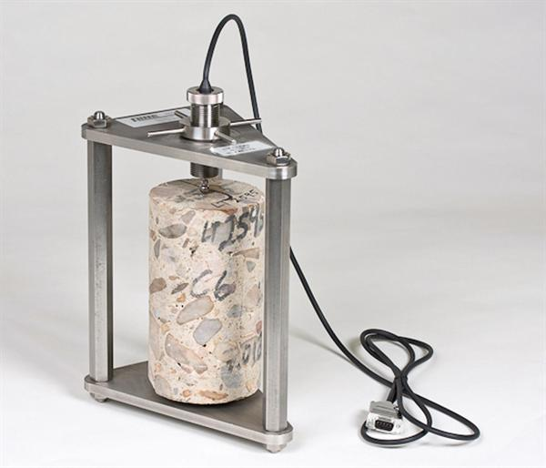
Measuring CTE
Spring Loaded LVDT
www.concreteconstruction.net
Testing Procedure: AASHTO T336
Specimen:
4 in dia. cores/cylinders
~ 6 to 8 in. long
Place in testing frame and submerge in water
Increase water temp to 50°C (120°F) – meas. length
Decrease water temp to 10ºC (50ºF) – meas. Length
Increase water temp to 50°C (120°F) – meas. length
*Must correct to account for thermal deformation of the frame using calibration specimen
Testing Frame
4” Dia. Core
University of California Pavement Research Center

Slide 44
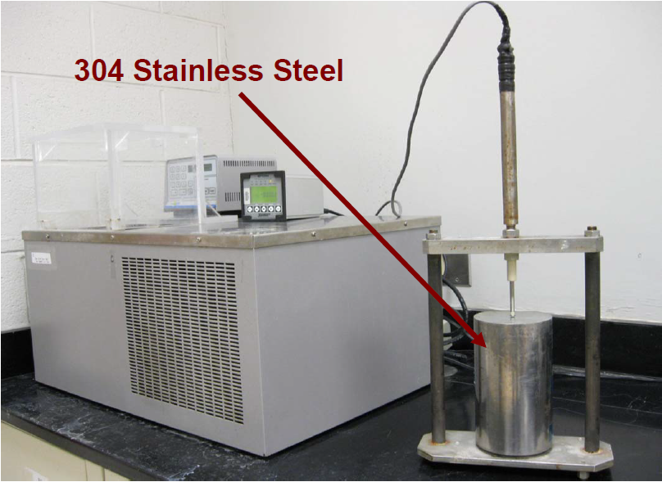
Error in estimating CTE
CTE of 304 SS calibration specimen was inaccurate over typical PCC service temperatures
0ºC – 500ºC → 17.3*10⁻⁶/ºC
10ºC – 50ºC → 15.8-16.2*10⁻⁶/ºC
Steel CTE too high → PCC CTE to high
LTPP database populated w/ incorrect CTEs
Recalibrate with correct CTEs

Slide 45
Recalibration
NCHRP Project 20-07/Task 288 initiated
Recalibrated:
JPCP (transverse cracking and faulting)
CRCP (crack width and punchout)
Task 288 models:
PCC thickness designs should be similar to original models
New calibration coefficients not implemented due to discrepancies in thickness designs

Slide 46
Resolution
NCHRP Project 20-07/Task 327
Objective:
Conduct an evaluation of recalibration effort under Task 288
Recommend recalibrated models that use accurate CTE values for incorporation into ME design software

