Slide 1
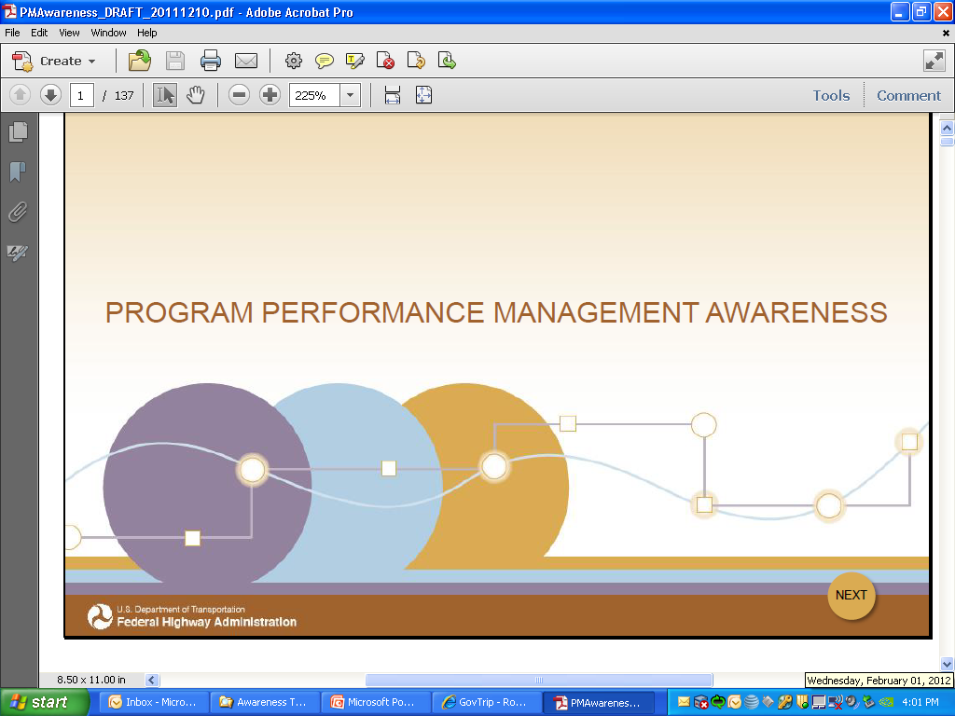
MAP-21
Moving Ahead for Progress in the 21st Century
An Update on Implementation of MAP-21 Performance Elements
Mark Swanlund
March 27, 2013

Slide 2
Performance Management Process
MAP-21: Identifies national goal areas
USDOT: establish measures, with input, within 18 months
MAP-21 thresholds
  Pavement condition on Interstate
  Bridge condition on NHS
States and MPOs:
  State targets within 12 months of USDOT establishment of measures
  MPO targets within 6 months of State establishment of targets
  Incorporate measures and targets into planning process
States report on progress toward targets
  Report within 4 years of enactment; biennially thereafter
  Insufficient progress toward NHPP/HSIP targets
    -> triggers corrective actions (not sanctions)
Notes:
There are three relevant terms that I would like to highlight initially;
National Goals
Performance Measures
Performance Targets
A “Goals” is a general statement of what we would like to do. ( example: is the room should be comfortably warm)
A “Measure” is how the goal is quantified (example: we will use the celsius scale to measure and the measurements will be taken every hour)
A “Target” is the value of the measure that will define success relative to the goal. ( example: the target temperature in the room is 21 C)
I will use these terms throughout the presentation.
The bill ( MAP-21)identifies a mixture of broad goal areas (safety, infrastructure condition, etc.) ( the highway system will be maintained in a state of good repair)
MAP-21 requires USDOT to establish, with input, the performance measures. In some cases Congress was more specific than others about what they wanted
After the measures are established, States and MPOs will set performance targets, and State and metro plans will describe how program and project selection help achieve these targets.
Then States will report to USDOT on their progress.
It’s worth noting that the reports will typically lead to corrective actions, but not sanctions.
There will be consequences if the condition of the NHS falls below thresholds established either by law (in the case of NHS bridges) or by USDOT (as required by MAP-21).
These consequences generally are loss of flexibility with funds rather than loss of funding.

Slide 3
Performance Measures
Highways
  Safety (4)
  Infrastructure Cond. (3)
  System Performance (2)
  Freight Movement (1)
  Traffic Congestion (1)
  On-Road Mobile Source Emissions (1)
Public Transportation
  “State of Good Repair”
  Condition of Assets
  Safety Performance Criteria
Highway Safety Programs
  14 Measures
  “Traffic Safety Performance Measures for States and Federal Agencies” 2008
Notes:
FHWA has 12 areas to develop measures.
These are:
– fatalities,
fatality rate,
serious injuries,
serious injury rate,
NHS bridge condition,
Interstate pavement condition,
NHS (excluding interstate) pavement condition,
Interstate Performance,
NHS (excluding interstate) performance,
freight movement on the interstate,
traffic congestion,
on-road mobile source emissions,
There are also measures for the public transportation, that relate the FTA and highway safety programs, that relate to NHTSA, that I will not get into today.
++++++++++++++++++++++++++++++++++++++++++++++++++++++++++++++++++++++++++++++++++++++++++++
For the purposes of carrying out the National Highway Performance Program USDOT will establish measures to assess:
Pavement condition – Interstate and NHS (excluding Interstate)
Bridge condition – NHS
Performance – Interstate and NHS (excluding Interstate)
These measures will be focused on the condition and performance of the Interstate and National Highway Systems as the purpose of the National Highway Performance Program is to:
Provide support for the condition and performance of the NHS
Provide support for the construction of new facilities on the NHS, and
Ensure that investments of Federal-aid funds in highway construction are directed to support progress toward the achievement of performance targets established in an asset management plan of a State for the NHS.
For purposes of carrying out the Highway Safety Improvement Program USDOT will establish measures to assess:
Fatalities – per VMT and number
Serious Injuries per VMT and number
These measures will address safety on all public roads as the purpose of the Highway Safety Improvement Program is to achieve a significant reduction in traffic fatalities and serious injuries on all public roads, including non-State-owned public roads and roads on tribal land.
For purposes of carrying out the Congestion Mitigation and Air Quality Improvement (CMAQ) Program USDOT will establish measures to assess:
Traffic congestion
On-road mobile source emissions
Although all States receive CMAQ funds only MPOs serving a TMA with a population > 1,000,000 representing a non-attainment or maintenance area will be required to submit a performance plan.
USDOT will also establish measures to assess freight movement on the Interstate system

Slide 4
Performance Measure Rule
Establishment of National Measures
  Measure Definition
  Data Elements
Setting Minimum Condition for Interstate Pavements
Outlining Target Setting Requirements
Defining Target Achievement
Outlining Performance Reporting Requirements
Notes:
FHWA will “promulgate rulemaking” (develop regulations) to define the 12 national performance measures.
The Performance Measure Rule will cover all the performance management requirements of MAP-21 including:
- Establishment of National Measures – measure definition (including the system to be addressed), data standards that could include data source, update frequency, data quality
- Minimum Condition allowable for Interstate Pavements – necessary to carry out NHPP
- Target Setting Requirements – requirements to ensure for consistency in how targets are set (the selected target will be a State and MPO decision).
- Progress Achievement – propose how “significant progress” will be defined to carry out the NHPP and HSIP target achievement requirements.
- Performance Report – outline requirements for State reporting on progress towards the achievement of targets.
It is anticipated that the rulemaking to proceed in several parts to allow the measures for more mature areas to be established soon and allow for more time to evaluate potential measures for areas that are not as mature in use.

Slide 5
Rulemaking Process/Timeline
Required to promulgate rulemaking within 18 months of October 1, 2012.
Rulemaking activities currently underway and include:
  Consultation with stakeholders
  Drafting of the Notice of Proposed Rulemaking (NPRM)
  Completion of an Economic Assessment that looks at the impact of the proposed rule on States, MPOs and other stakeholders.
  Coordination with other rulemakings, i.e. Planning, Asset Management Plan, FTA
90 day minimum comment period required after NPRM is published.
Publication of final rule in Federal Register and an effective date.
Notes:
Most of the effort to develop the rules will happen over the next 1 ½ to 2 yrs.
Current rulemaking activities include:
- Consultation with stakeholders – mention the National Online Dialogue, The Thought Leaders Roundtable and the Virtual Town Hall Meeting
- Drafting of the Notice of Proposed Rulemaking (NPRM) is proceeding with a multi-modal team from OST, FTA, and NHTSA
- Preparing an Economic Assessment that looks at the impact of the proposed rule on States, MPOs and other stakeholders.
There are also other related rulemaking efforts underway that need to be coordinated. These include Planning, Asset Management Plan, FTA
Once we complete the NPRM, there is a minimum 90-day comment period, required by MAP21 to receive comments on the proposed rule. These comments will be submitted through an official regulatory docket and considered in the final rule.
Lastly, after the final rule is published in the Federal Register, it will include an effective date to assist States and MPOs in transitioning to setting the required targets

Slide 6
GROUP MEASURES BASED ON READINESS
PROGRAM | MEASURE CATEGORY
STATUS I | Serious Injuries per VMT
 | Fatalities per VMT
 | Number of Serious Injuries
 | Number of Fatalities
STATUS II | Pavement Condition on the Interstates
 | Pavement Condition on the Non-Interstate NHS
 | Bridge Condition on NHS
STATUS III | Traffic Congestion
 | On-road mobile source emissions
 | Freight Movement
 | Performance of Interstate System
 | Performance of Non-Interstate NHS
Notes:
FHWA has proposed to develop the entire measures rulemaking process in 3 stages that reflect the readiness of the proposed measure.
The readiness level of each performance measure varies greatly among legislated measure categories, the readiness for rulemaking differs considerably among the categories. This chart describes the twelve measure categories, classified into the three groups (Status I through III) depending on the readiness of each performance measure. Status I recommended measures are complete and its elements are in place to issue NPRM, Status II measures have a recommended measure but additional work is needed to develop supporting elements needed for NPRM, and Status III measure indicated that a measure still being considered.

Slide 7
STAGED RULE SCHEDULE
Measures / Fiscal Year |  | Safety Measures | Pavement & Bridge Measures | CMAQ, Performance, and Freight Measures
FY / QUARTER |  | Status I | Status II | Status III
FY13 (Year 1 of MAP-21) | Q1 | Consultation/NPRM | Consultation/NPRM | Consultation/NPRM
 | Q2
 | Q3
 | Q4
FY14 (Year 2 of MAP-21) | Q1 | Comments
 | Q2 | Final Rule | Comments
 | Q3 |  | Final Rule | Comments
 | Q4 |  |  | Final Rule
FY15 | Q1
 | Q2
Notes:
This is our tentative schedule - Issue 3 complete and separate rules -Stagger each by approximately 3 months
Group rules based on following considerations:
Each NPRM will have a separate final rule
Establish one effective date for all measures - Approximately Spring 2015
First NPRM
Discuss overall approach to issuing proposals for all measure areas
Propose measures in the safety area
Second NPRM
Propose measures to carry in the infrastructure area
Third NPRM
Discuss the regulatory impacts resulting from all of the measures
Propose measures to carry out the measures for air quality, congestion mitigation, performance requirements of the NHS, and freight.

Slide 8
Performance Plans
Performance Reports
Safety
Asset Management
Metro System Performance
Transit Performance
Highway Performance
Safety Performance
Congestion & Air Quality
Metro System Performance
Congestion & Air Quality
Freight
5 Yr Report to Congress
Conditions and Performance
Transportation Improvement Programs
Notes:
Measures don’t do much good unless you do something with them.
MAP-21 requires that performance measures be integrated into the planning and reporting process. Current and future plans shall note how the proposed activity will address the measures and state –selected targets. The performance plans will include the actual progress made in achieving those targets.
++++++++++++++++++++++++++++++++++++++++++++++++++++++++++++++++++++++++++++++++++++++++++++++++++
Planning Regulations – cover new and changed requirements under 23 U.S.C. 134 and 23 U.S.C. 135. The performance elements to be addressed through rulemaking include:
Performance-Based Approach – outline requirements to be met (addressing national goals, target setting, coordination)
System Performance Report – requirement that Metropolitan Transportation Plans include this new report (optional in the Statewide Transportation Plan).
Target Achievement Discussion – requirement to include a discussion in the STIP and TIP how the program will achieve targets the State/MPO have set for performance.
Transition Period – when the performance-based approach needs to be implemented into the planning process.
Asset Management Plan Process – cover new requirements to develop an asset management plan under the NHPP. Will outline process requirements and minimum standards for States to use to develop and operate pavement and bridge management systems. Will identify timing required to implement these provisions.
Highway Safety Improvement Program – cover new requirements under the Highway Safety Improvement Program. Will outline requirements to update Strategic Highway Safety Plans, implementation of special safety rules, and performance reporting requirements.
CMAQ Program – cover new requirements under the CMAQ program. Will outline requirements for MPOs to develop a Performance Plan.

Slide 9
Performance Targets
States, MPOs, and public transit providers set targets for each of the measures
Coordination between States, MPOs and public transit providers to ensure for consistent targets
Option to set different targets for urban and rural locations
Identified through planning process with reference to individual performance plans
Notes:
The states will select the targets
When a measure applies to a metropolitan area, the metropolitan area will select their target. It is required that targets set by MPOs be developed “in coordination” with the state.
There is an option to set separate targets for urban and rural locations.
Regulation/guidance will clearly identify when, where, and how the targets will be submitted

Slide 10
Performance Accountability
Target Achievement Requirements
  National Highway Performance Program
  Highway Safety Improvement Program
Metro Planning Certification Review
Statewide Performance-Based Planning Process Evaluation
5 Year Progress Evaluation of each State and each MPO
Notes:
There are specific requirements to achieve specific targets contained in MAP-21.
These include:
Interstate Pavement Condition– if condition falls below minimum threshold (set by DOT for 2 consecutive reporting periods then:
a portion of the of federal funding must be used for pavement improvements. This requirement stays in effect until the minimum thresholds can be met.
Will administer compliance with this requirement 2 yrs after measure is established (likely 2017)
The minimum standard for Interstate pavement condition will be established in the measure rule for 23USC150(c). USDOT may identify different minimum condition levels for geographic regions if it is determined that various regions of the United States experience disparate factors contributing to the condition of the pavement.
NHS Bridge Condition– if condition results in 10% or more structurally deficient bridges (weighted by deck area) for 3 consecutive years then:
A portion of the federal funding will be set aside for bridge improvements. This requirement stays in effect until the minimum thresholds can be met.
This requirement will be assessed for compliance at a date that will provide for 3 full years of data after the establishment of the new NHS.
High-Risk Rural Road Safety– fatality rate on rural roads increases over the most recent 2 yr period then:
A portion of the safety funds will be set aside to address fatalities on rural roads.
This requirement will be in effect on the date of enactment of MAP-21 as data are available today assess compliance.
Older Drivers– fatalities and serious injuries per capita of drivers over the age of 65 increases for the most recent 2 yr period then:
Subsequent SHSP must identify how the State intends to address older driver safety
This requirement will be in effect when 2 full years of data are available to assess compliance.
USDOT will evaluate the effectiveness of the performance-based approach to Statewide planning. This evaluation will consider:
The extent to which the State is making progress toward achieving, the performance targets, taking into account whether the State developed appropriate targets.
The extent to which the State has made transportation investments that are efficient and cost-effective
The extent to which the State:
Has developed an investment process that relies on public input and awareness to ensure that investments are transparent and accountable, and
Provide reports allowing the public to access the information being collected in a format that allows the public to meaningfully assess the performance of the State.

Slide 11
Stakeholder Outreach
Methods of Outreach
  Webinars
  National Online Dialogues
  Virtual Town Hall Meetings
  Subject Matter Meetings
  Direct Contact to FHWA :
  PerformanceMeasuresRulemaking@dot.gov
Focused Areas for Outreach
  Performance Measures
  Target Setting Listening Session
  Reporting and Assessment
Notes:
We have been reaching out to stakeholders to better understand their thoughts regarding implementation of the performance elements of MAP-21. These efforts have included the delivery of webinars, holding online dialogues, holding meetings, and holding listening sessions. We will continue to hold these types of events to better understand stakeholder thoughts and opinions and we are striving to improve the quality of these sessions based on feedback we receive. The information captured during these events will be used to help develop proposed measures and will be summarized as background information in the proposed rule. A summary of these events is provided below:
Webinars – we have held and will continue to hold informational webinars on elements of MAP-21.
National Online Dialogue – at the end of September we held a virtual dialogue to hold a discussion with the public on ideas they had regarding performance measures. The dialogue generated over 200 ideas that were discussed using the online platform by over 8,000 visitors. Over 50% of the comments were related to the system performance and traffic congestion measure areas.
Meetings –we have met with specific groups to listen to their input regarding different aspects of MAP-21 performance elements. These meetings can continue provided they are conducted before the issuance of an NPRM.
Listening Sessions – we have held listening sessions around different topics to engage with stakeholders to better understand how different ideas for measures can be implemented. In the recent session on target setting, about 150 stakeholders including State DOTs, MPOs and transit agencies across the country participated in the MAP-21 Performance Management Listening Session on Target Setting via video conference set-up in 14 Division Offices on January 8, 2013. Below is a general summary of conversations held at the January 8th stakeholder input session:
Setting Targets: Target setting will require flexibility, experimentation, and coordination.
Telling a National Story: Several stakeholders expressed that there is a need to provide reporting that is meaningful to citizens: .
Assessing Progress: Regarding targets there may be some understood assumptions that we will not know what works until we try it, and that FHWA should help States try it without worrying about being evaluated. .

Slide 12
Upcoming Outreach Activities
February 2013: Launch TPM Website, including community of practice - completed
March/April 2013: Launch of MAP-21 PM Research Web Conference Series (5 web-conferences)
April 2013: Targeted Listening Session on MAP-21 Reporting Requirements
May 2013: Week of May 13: USDOT Transportation Data Industry Day
June 2013: Week of June 10th (during TRB mid-year meeting): Targeted Listening Session on MAP-21 Data, Data Analysis and Tools, and Data for Decision-making

Slide 13
More Information
MAP-21 website (www.fhwa.dot.gov/map21)
  Bill summary and funding tables
  Fact sheets and Q&As
  Presentations
  Points of contact
  Recordings of webinars
  (http://www.fhwa.dot.gov/map21/webinars.cfm)
FHWA Performance Management Website (www.fhwa.dot.gov/tpm )
Training and Support (under development)
Notes:
On our MAP-21 website are a host of resources to assist in understanding how MAP-21 is being implemented. Some of these resources include:
Bill summary and funding tables
Fact sheets and Q&As
Presentations
Points of contact
Recordings of webinars (http://www.fhwa.dot.gov/map21/webinars.cfm)
FHWA Offices are currently integrating performance management program delivery into their various programs. For example, the Office of Planning has a website devoted to performance based planning and programming. We are currently developing an FHWA website focused on Performance Management that should be up and running sometime early this year.
Lastly, the Office of Transportation Performance Management is working to ensure that FHWA and our stakeholders have the necessary training and support to build the required competencies to implement a performance-based Federal Highway program.

