Slide 1

Real-time monitoring of Bridge Pier scouring during Flood events
RFID Center of Excellence
Director: Dr. Marlin H. Mickle
Co-Director: Dr. Ervin Sejdić
Graduate Students: Nicholas Franconi
Michael Rothfuss

Slide 2
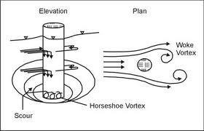
Bridge Scour Monitoring
RFID Center of Excellence
Pennsylvania currently owns 25,000 bridges with an average age of 50 years.
As of June 2012, there are approximately 4,700 structurally deficient bridges in the state.
These bridges are susceptible to bridge scour, the washing away of sediment around structures, which compromises the safety of the bridge.

Slide 3
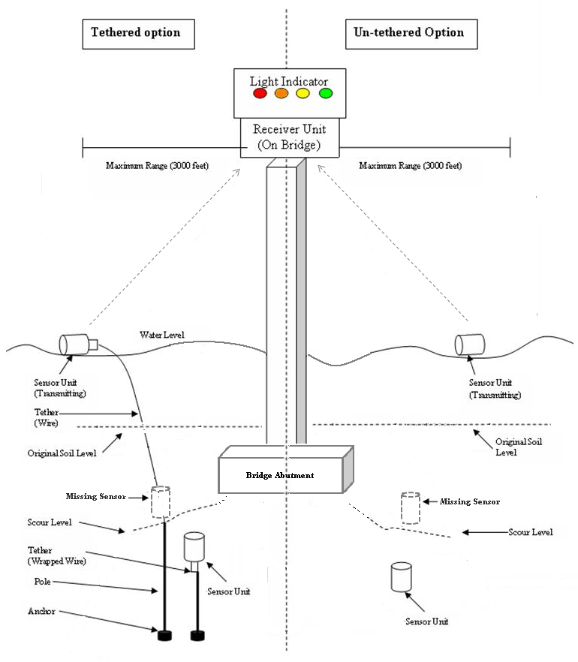
Bridge Scour Monitoring
RFID Center of Excellence
Float out devices are typically used for the detection of bridge scour on smaller bridges.
  The float out device concept is to bury devices at various locations and depths around a bridge structure.
  These devices would then be released due to the scour’s removal of material around the device.
  A receiver on the bridge communicates with the released device.
A float out device system would provide an initial indication of scour severity for further investigation.
Notes:
Find Images of Scour Critical Bridges

Slide 4
Project Overview
RFID Center of Excellence
A prototype remote sensing system was designed to have three main components that will provide an real-time estimation of the current bridge scour status.
Sensor Unit
  RF transmitter in a watertight capsule that will remain in an off-state in the ground. The sensor unit will become active upon its release, rising to the surface.
Receiver Unit
  RF Receiver capable of interpreting transmissions from the sensor units and provides scour status updates to the Light Indicator unit.
Light Indicator Unit
  A set of LEDs encased with supporting circuitry that receives scour status updates from the Receiver Unit and provides a visual indication (LEDs) of the current scour status.
Notes:
Clear distinction between Phase-1 and Phase-2 Projects
Show Phase 1 Sensor Unit

Slide 5
Phase 1 - Overview
RFID Center of Excellence
Sensor Unit
  Hardware Architecture
  Dormant Power Mode
  Software Architecture
Receiver Unit
  Hardware Architecture
  Software Architecture
Light Indicator
  Hardware Architecture
Rise Time Analysis and Results
Transmission Collision Analysis
Antenna Orientation Analysis

Slide 6
Phase 1 – Sensor Unit
RFID Center of Excellence
PennDOT Requirements for the Sensor Unit
  The Sensor Unit must be fabricated in an RF friendly, watertight, cylindrical container
  The Sensor Unit must be sufficiently buoyant to rise to the water surface within range of the Receiver Unit
  The Sensor Unit must contain:
    An ISM Band RF Transmitter
    A positional orientation sensitive switch
    An external arming and disarming switch
  The Sensor Unit must activate and transmit upon deviation from vertical orientation
  The Sensor Unit must transmit within range under flood conditions
  Tethering the Sensor Unit to an anchor must be analyzed
  The Sensor Unit must transmit information identifying the bridge and structure assigned, a serial number, and the severity of the scour
  The Sensor Unit must be installed using a standard NX (3-3/16 inch interior diameter) hollow stem auger
  The Sensor Unit must provide depth accuracy to ±1 foot.

Slide 7
Phase 1 – Sensor Unit
RFID Center of Excellence
Notes:
Hardware Architecture
Texas Instruments MSP430
Linx TRM-433-LT 433MHz Transceiver
FTDI FT232 UART to USB

Slide 8
Phase 1 – Sensor Unit
RFID Center of Excellence
Notes:
Hardware Architecture
Texas Instruments MSP430
Linx TRM-433-LT 433MHz Transceiver
FTDI FT232 UART to USB

Slide 9
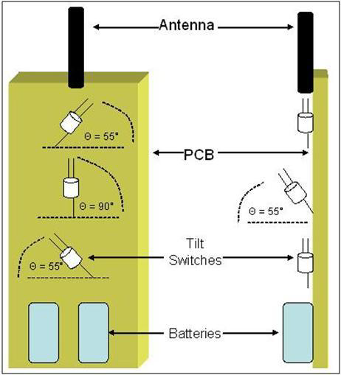
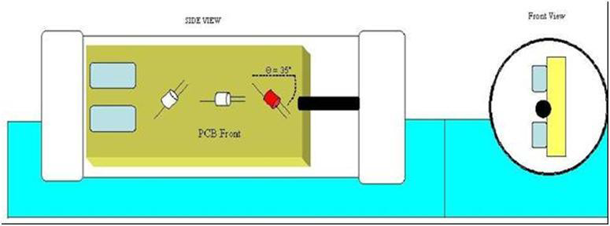
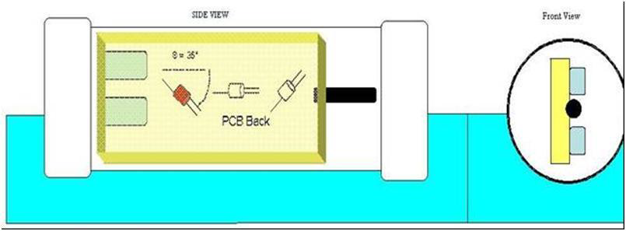
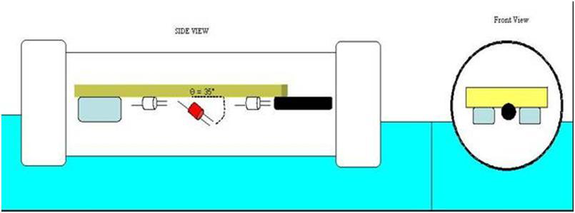
Phase 1 – Sensor Unit
RFID Center of Excellence

Slide 10
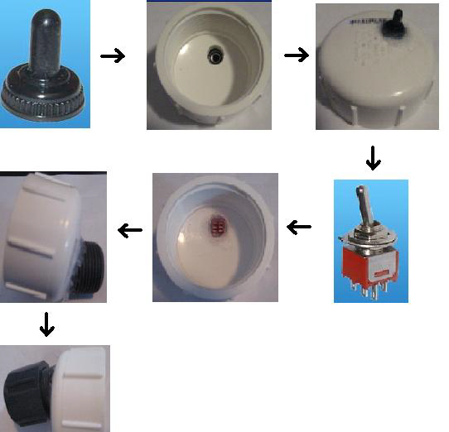
Phase 1 – Sensor Unit
RFID Center of Excellence
The external reset switch enables the user to reset the Sensor Unit without opening the capsule.
This switch allows the Sensor Unit to be tested immediately before it is installed and then reset.
The external switch must be durable and watertight.
Notes:
First, a hole must be machined in the PVC cap.
The rubber boot is then placed on the hole and sealed on the outside of the PVC cap using the silicon sealant.
The switch is then placed in the machined hole and rubber boot. The switch and hole are completely covered with silicon sealant. This includes the leads of the switch, which should be wired prior to this step.
Lastly, a 1 inch diameter PVC nipple is placed around the switch and sealed using the silicon sealant. The threads and cap are sealed in the same manner as the main capsule. This described in detail in the next section.

Slide 11
Phase 1 – Receiver Unit
RFID Center of Excellence
PennDOT Requirements for the Receiver Unit
  The Receiver Unit must be placed at a fixed position on the bridge
  The Receiver Unit must receive and store Sensor Unit messages
  The Receiver Unit must interpret Sensor Unit messages
  The Receiver Unit must control a Light Indicator (visual indication of scour) based on Sensor Unit messages received
  The Receiver Unit must provide a communication mechanism to allow bridge inspectors to download stored Sensor Unit messages
  The Receiver Unit must provide a communication mechanism to allow bridge inspectors to reset the Receiver Unit to a no alarm condition
  The Receiver Unit must provide a communication mechanism to allow bridge inspectors to reset the Receiver Unit to erase all stored Sensor Unit messages

Slide 12
Phase 1 – Receiver Unit
RFID Center of Excellence
Notes:
Hardware Architecture
Texas Instruments MSP430
Linx -433-LT 433MHz Transmitter
FTDI FT232 UART to USB

Slide 13
Phase 1 – Receiver Unit
RFID Center of Excellence

Slide 14
Phase 1 – Light Indicator Unit
RFID Center of Excellence
PennDOT Requirements for the Light Indicator Unit
  The Light Indicator will indicate four different levels of scour.
  The Light Indicator must be visible to the inspector without the inspector being on the bridge, i.e., from the bridge approach

Slide 15
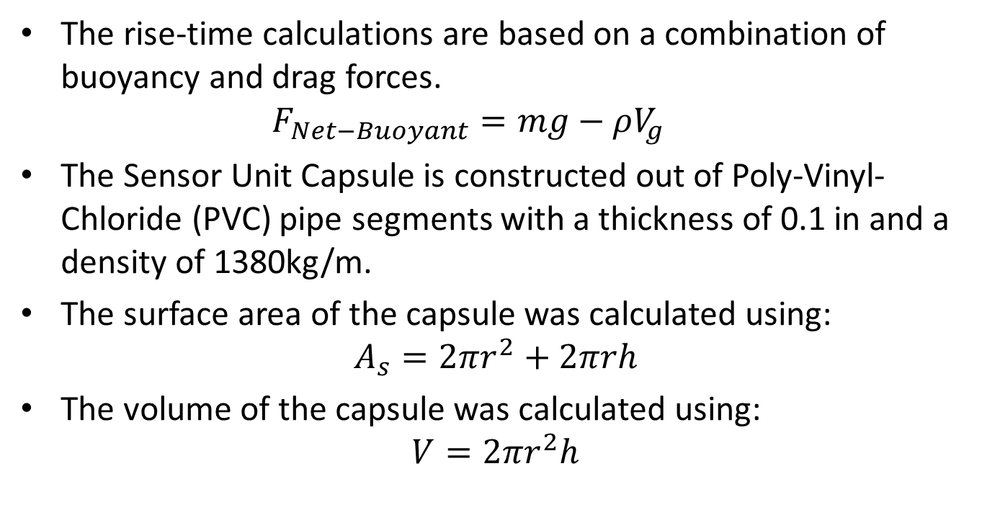
Phase 1 – Rise Time Analysis
RFID Center of Excellence
The rise-time calculations are based on a combination of buoyancy and drag forces.
  $$F_{Net−Buoyant}=mg−ρV_{g}$$
The Sensor Unit Capsule is constructed out of Poly-Vinyl-Chloride (PVC) pipe segments with a thickness of 0.1 in and a density of 1380kg/m.
The surface area of the capsule was calculated using:
  $$A_{s}=2πr^{2}+2πrh$$
  The volume of the capsule was calculated using:
  $$V=2πr^{2}h$$
Notes:
Buoyancy Calculation
m is the mass of the object
g is the acceleration due to gravity
V is the volume of the object
p the density of the fluid the object is in
The density of water is 1000 Kg/m3.

Slide 16
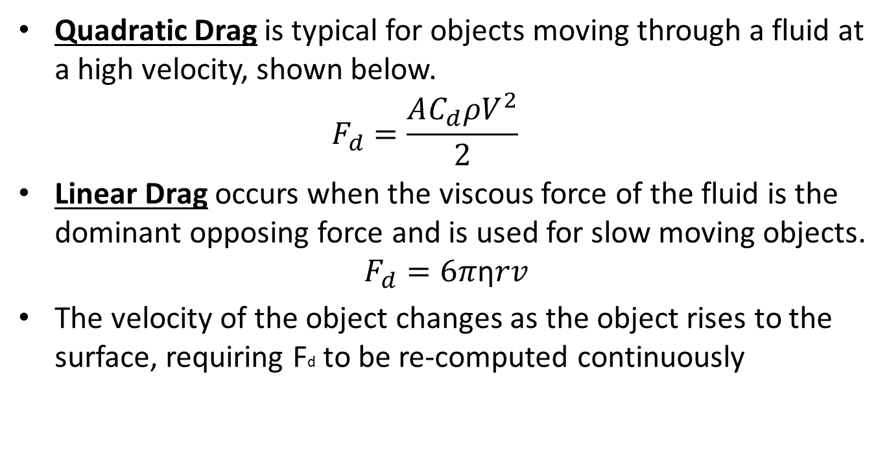
Phase 1 – Rise Time Analysis
RFID Center of Excellence
Quadratic Drag is typical for objects moving through a fluid at a high velocity, shown below.
    $$F_{d}=\frac{AC_{d}ρV^{2}}{2}$$
Linear Drag occurs when the viscous force of the fluid is the dominant opposing force and is used for slow moving objects.
$$F_{d}=6π\text{η}rv$$
The velocity of the object changes as the object rises to the surface, requiring Fd to be re-computed continuously
Notes:
Quadratic Drag
Fd is the force due to drag
Cd is the drag coefficient, a unit-less number found by experimentation, Cd = 1.17
p is the density of the fluid
V is the velocity of the object
A is the cross-sectional area of the surface
Linear Drag
η is the viscosity of the fluid (water = 1.12g/(m*s))
r is the Stokes radius (radius, center to exterior of capsule, of the capsule in this case)
v is the velocity of the object.
A simulation was developed in MATLAB to calculate the Quadratic Drag in 1 milli-second steps that updated the velocity and re-computes the drag force, Fd, for each unit of time.
Using smaller discrete time step, 1 micro-second, showed changes only in the fifth significant digit, so a 1 milli-second time-step was used.

Slide 17
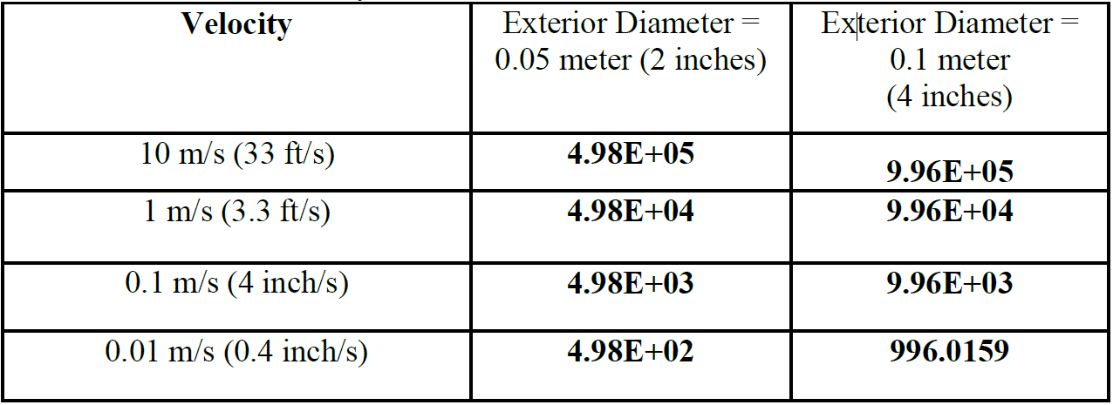
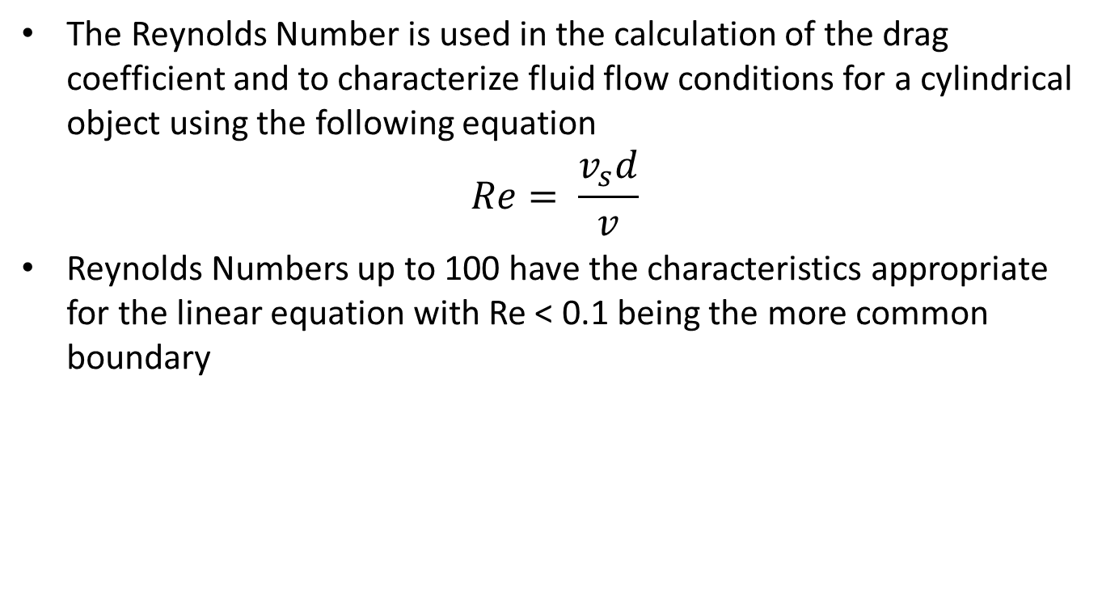
Phase 1 – Rise Time Analysis
RFID Center of Excellence
The Reynolds Number is used in the calculation of the drag coefficient and to characterize fluid flow conditions for a cylindrical object using the following equation
$$Re= \frac{v_{s}d}{v}$$
Reynolds Numbers up to 100 have the characteristics appropriate for the linear equation with Re < 0.1 being the more common boundary
Notes:
Large Reynolds numbers indicate that the quadratic drag equation should be used, whereas lower numbers indicate that the linear drag equation should be used.
vs is the velocity of the object
d is the diameter of the cylinder
v is the absolute kinetic viscosity of the fluid the object moves through.

Slide 18
Phase 1 – RF Float Out Properties
RFID Center of Excellence
Because the critical factor is to verify if the Sensor Unit will surface within range of the Receiver Unit and is based on the computed Reynolds Numbers, the calculated values used are from the Quadratic Drag Equation.
The results computed using the Quadratic Drag Equations are consistently larger than those computed using the Linear Drag Equations.

Slide 19
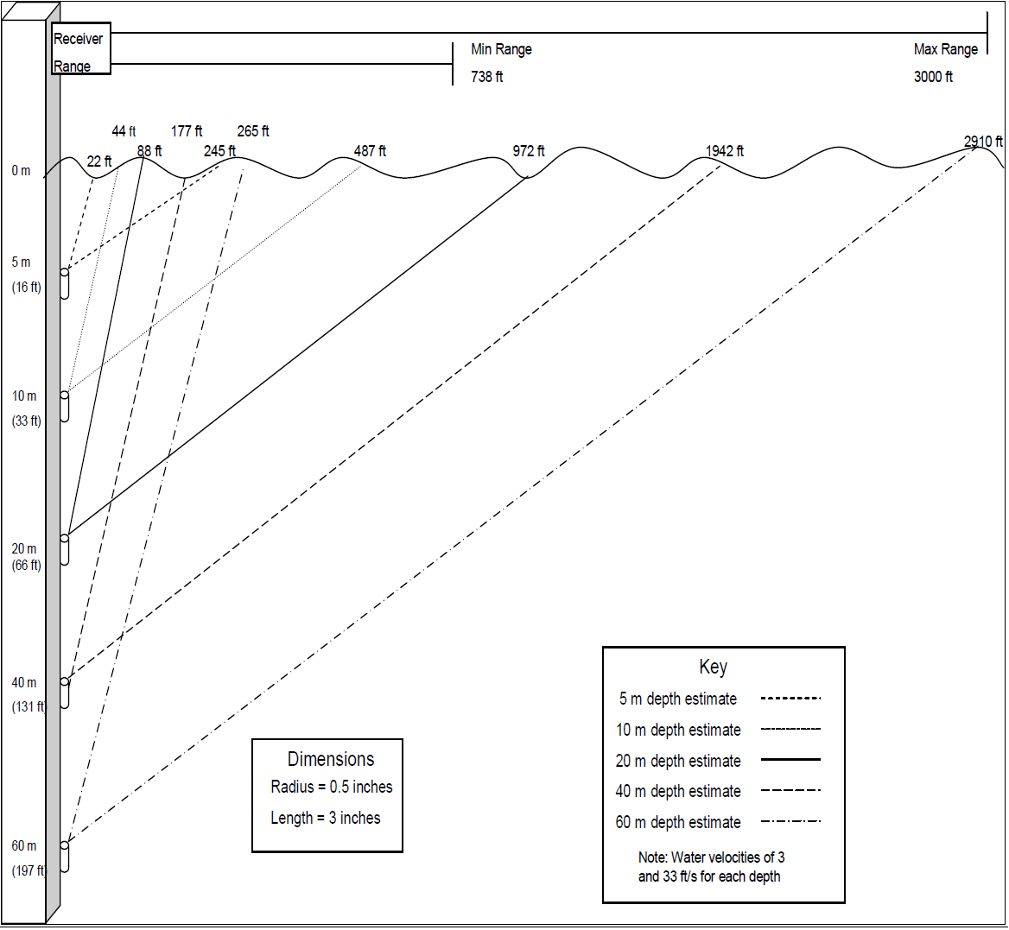
Phase 1 – RF Float Out Properties
RFID Center of Excellence

Slide 20
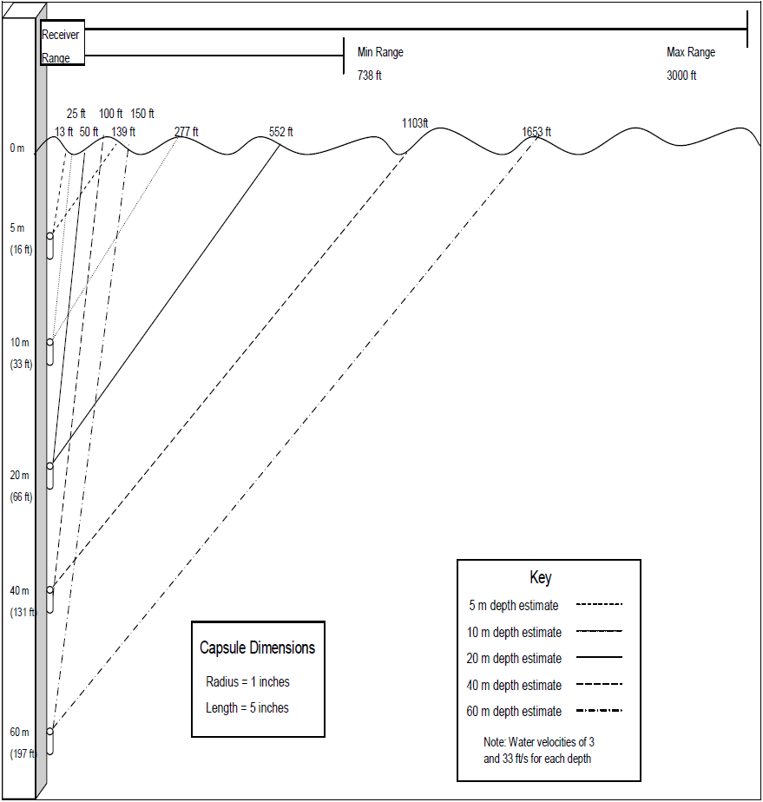
Phase 1 – RF Float Out Properties
RFID Center of Excellence

Slide 21
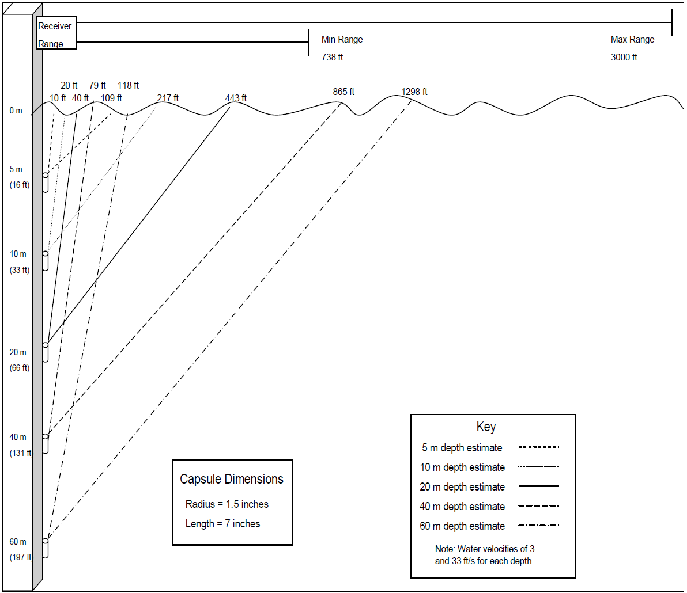
Phase 1 – RF Float Out Properties
RFID Center of Excellence

Slide 22
Phase 1 – Collision Analysis
RFID Center of Excellence
The use of multiple, independent Sensor Units within the system introduces a chance of collision.
  A collision occurs when Sensor Units float out at the same time and transmit on the same channel to the same receiver causing the packets to overlap and interfere with each other.
Custom Collision Algorithm for Scour Applications
  The Receiver Unit will ignore a message containing an error to give each Sensor Unit a strong probability of having its message accepted at the Receiver Unit.
  Varying transmission delay lengths are randomly generated at multiples of the 2T transmission length of the message (2T, 4T, 8T, 16T).
  High priority Sensor Units transmit more frequently based on preselected percentages.
Notes:
Initial Collision Algorithm
If the Sensor Units could be scheduled to transmit at certain known times, a delay of T could be added in between each Sensor Unit’s transmissions, avoiding collisions.
A centralized synchronizing agent is required to schedule the transmissions. The time at which a Sensor Unit will begin transmitting cannot be scheduled because the unit will be released by natural events. The centralized synchronizing agent is not an option for this application.
Collision Algorithm
Varying transmission lengths give a 25% chance of collision after the first transmission decreasing exponentially after

Slide 23
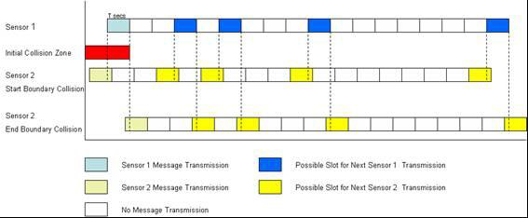

Phase 1 – Collision Analysis
RFID Center of Excellence
Notes:
Collision Scenario with Delays Added
Delay Percentages for Each Color Code, T ≈ 100 ms

Slide 24
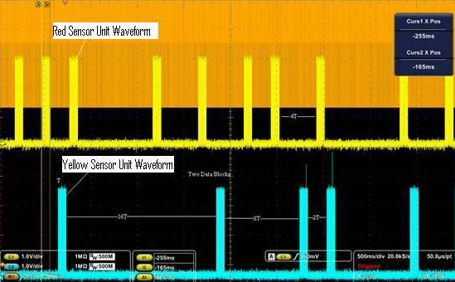
Phase 1 – Collision Analysis
RFID Center of Excellence

Slide 25
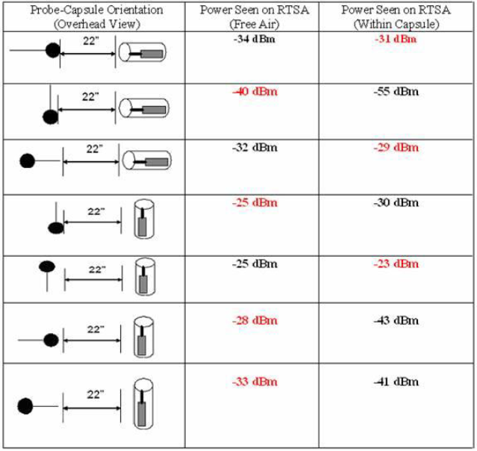
Phase 1 – RF Strength Test
RFID Center of Excellence
This table contains the results of the transmitting power in free-air and from within the Capsule.
These tests were done at several orientations for both the RTSA probe and the transmitter.
The number highlighted in red is the stronger signal.
The results show that the transmitter signal is well above the required -112 dBm for the receiver
Notes:
The results also show that there is no substantial degradation of the signal when the transmitter is placed within the capsule.
In fact, in several instances the signal was stronger from within the capsule.
Omnidirectional antenna for testing but isn’t best solution.
We can provide higher gain in specific direction to increase the performance of the system.

Slide 26
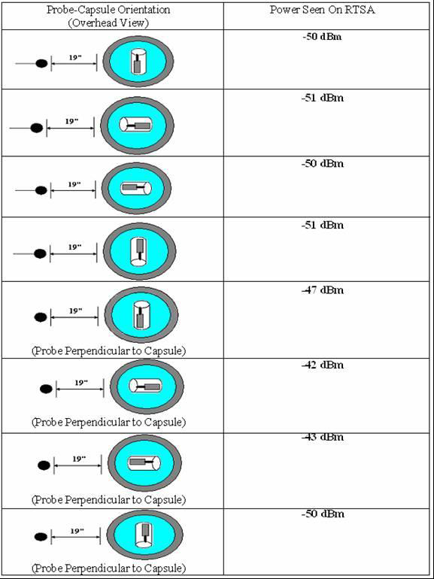
Phase 1 – RF Strength Test
RFID Center of Excellence
This table contains the results of the transmitting power while the capsule is floating in a horizontal orientation.
For each probe orientation, multiple readings were taken with the capsule antenna pointing in four different directions.

Slide 27
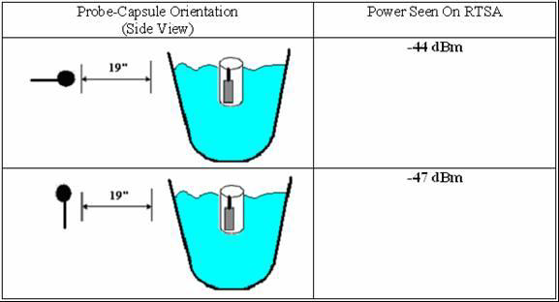
Phase 1 – RF Strength Test
RFID Center of Excellence
Table shows the transmitting power while the capsule is floating in a vertical orientation.
In comparison to the horizontal floating test, the results were similar with the received power readings
The horizontal orientation is recommended because of its simpler design and construction requirements.

Slide 28
Phase 2 - Overview
RFID Center of Excellence
Sensor Unit - Redesign
  Hardware Architecture
  Software Architecture
Receiver Unit - Redesign
  Hardware Architecture
  Software Architecture
  Light Indicator Unit Hardware

Slide 29
Phase 2 – Sensor Unit
RFID Center of Excellence

Slide 30
Phase 2 – Sensor Unit
RFID Center of Excellence

Slide 31
Phase 2 – Receiver Unit
RFID Center of Excellence

Slide 32
Phase 2 – Research
RFID Center of Excellence
Addition of Power Amplifier to Sensor Unit
Polyurethane Foam to Protect Internal Circuitry of Sensor Unit
Sensor Unit Reset Switch Re-design
Patch Antenna(s) for Receiver Unit
Toggle Switch to Activate LEDs on Receiver Unit
Solar and Battery Solution to Power Receiver unit

Slide 33
Questions?
RFID Center of Excellence

